Slide 1

DE Cancer Consortium and Screening for Life
State wide Lung CA Screening Program 2015
Stephen S Grubbs, MD
DE Cancer Consortium Annual retreat
April 14, 2015

Slide 2
The Lung Cancer problem
Leading Cause of Cancer Deaths in the World, in the USA, in Delaware
More Lung Cancer Deaths Annually than Breast, Colorectal, and Prostate Cancers Combined
Only 18% Alive at 5 Years
2786 DE Lung Cancer Deaths from 2006 to 2010
557 DE Deaths Annually
Prevention by Smoking Cessation remains the most important goal

Slide 3
The DE Lung Cancer problem
Leading Cause of DE Cancer Mortality
2786 Lung Cancer Deaths from 2006 to 2010
557 Deaths Annually
Estimated 32,000 Delawareans eligible for Lung Screening
Prevention by Smoking Cessation remains the most important goal

Slide 4
History of Lung CA Screening
Multiple trials with chest radiography (CXR) and sputum cytologies resulting in NO reduction of mortality
Uncontrolled trials in Japan, Europe, and US employing CT imaging
    CA & non CA nodule detection: CT more sensitive than CXR
    Feasibility of lower Dose CT (75-80% less than conventional CT)
    Harms of screening minimized by follow up protocols with non invasive monitoring.

Slide 5
International Early lung cancer action program (I-ELCAP)
Uncontrolled Low Dose CT Screening
Helen F Graham Cancer Center participation
5 Year Survival Benefit of screened versus historical controls (NEJM 2006)
Results vulnerable to bias
    Lead time bias
    Over diagnosis
Need for a randomized trial

Slide 6
National Lung Screening Trial (NLST)
(NEJM 8/4/2011)
NCI Sponsored Prevention Trial
      50,000 participants at 33 US centers
CT Technology
  Low Dose
  CT quality published
Lung Nodule Evaluation
  Multidisciplinary Team (MDT)
  Algorithms

Slide 7
National Lung Screening Trial
(NEJM 8/4/2011)
Annual Low Dose CT versus CXR for 3 years
High risk Population
  Age 55 – 74 years
  > 30 pack years
  Active smoker or quit < 15 years
  No recent CT (within 18 months)
20% Lung CA mortality reduction

Slide 8
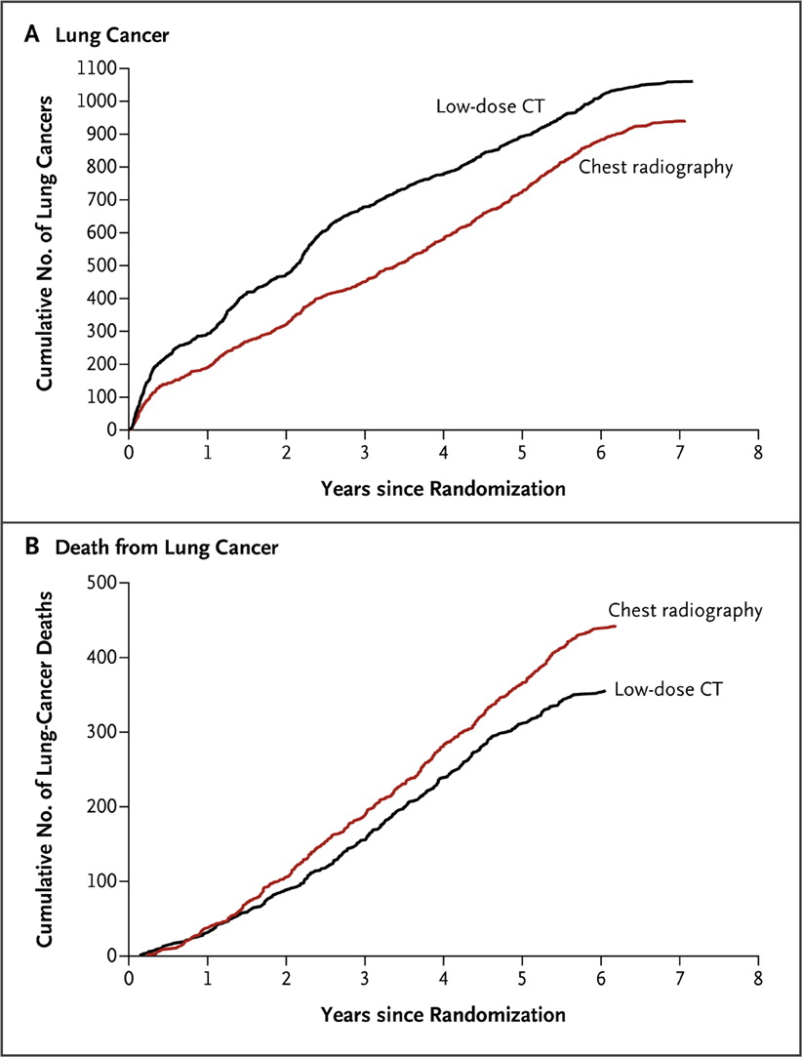

The National Lung Screening Trial Research Team . N Engl J Med 2011;365:395-409.
Cumulative Numbers of Lung Cancers and of Deaths from Lung Cancer.
Notes:
Figure 1. Cumulative Numbers of Lung Cancers and of Deaths from Lung Cancer. The number of lung cancers (Panel A) includes lung cancers that were diagnosed from the date of randomization through December 31, 2009. The number of deaths from lung cancer (Panel B) includes deaths that occurred from the date of randomization through January 15, 2009.

Slide 9
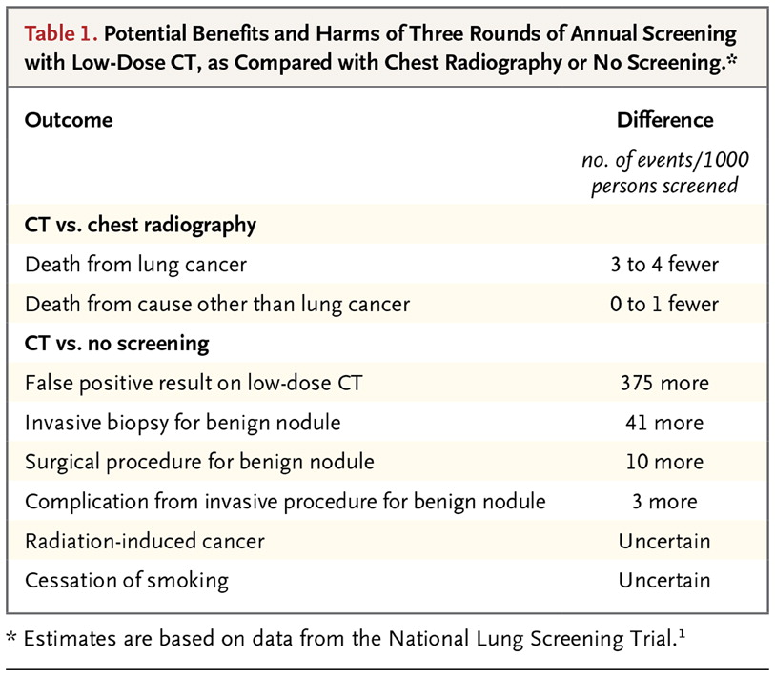
Gould MK. N Engl J Med 2014;371:1813-1820.
Potential Benefits and Harms of Three Rounds of Annual Screening with Low-Dose CT, as Compared with Chest Radiography or No Screening.

Slide 10

2014 DE Cancer Consortium Report

Slide 11
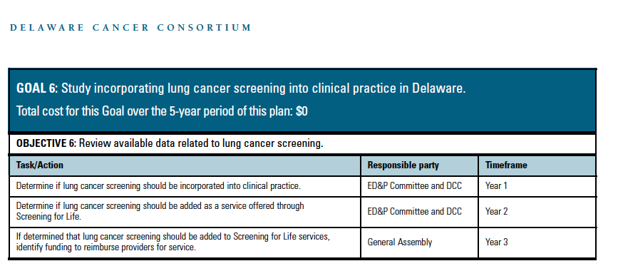
Early Detection and Prevention Committee

Slide 12
NCCN LDCt Program Recommendations
Sophisticated multidetector CT scanner and analytic software
Professional physicists & staff certify equipment & radiation exposure
Qualified Radiologist
Appropriate Guidelines
Reliable communication to the primary care physician
Medical Environment
    MDT management
    Track screened individuals
    Document outcomes

Slide 13
DE Screening For Life Program Features
Screening for the uninsured
Nurse navigation and standardized PCP reporting and consultation
Strict screening eligibility
Contracted radiology sites and radiologists meeting standards
Contracted multi disciplinary management teams meeting standards
Management and reporting algorithms
Data collection and storage
Audits of imaging and management quality
Integrated Smoking Cessation Programs

Slide 14
2015 Fiscal Year Status
2015 Fiscal Year Budget for Screening for Life (SFL) Lung Screening
    $1.5 million for SFL Lung Screening
    Systems and Infrastructure Development (includes Nurse Navigator)
    Marketing and Awareness
    Screening for up to 2300 persons ($900,000)
SFL covers uninsured and lung CA screen funded from Delaware
SFL will cover
    Low Dose Helical CT and interpretation
    Multi Disciplinary Team (MDT) evaluation and subsequent testing
    If cancer, then coverage transfers to DE CA Treatment Program

Slide 15
Lung Cancer
Screening Guidelines
RISK STATUS FOR SCREENING
RISK Assessment
High Risk (must meet all criteria below)
Age 55-80
> a 30 pack year history of smoking
Currently smoke or have quit in the past 15 years
No chest CT in past 12 months
Smoking history present or past (12)
Baseline Low-Dose CT
(LDCT), 100 – 120 kVp & 40-60 mAs or less

Slide 16
Patient Pathway
Referral to SFL for Lung Cancer Screening by: PCP, self-referral, Pulmonologist, Nurse Navigator, Radiologist
CT- CAT Scan
HPC- Health Program Coordinator
MDT- Multi Disciplinary Team
NN -Nurse Navigator
PCP- Primary Care Physician
SFL-Screening for Life
RX- Prescription/Referral
SFL Lung Cancer Screening Eligible
SFL HPC refers patient to NN
NN calls the patient within 3 business days
NN makes two contacts by phone if unsuccessful NN sends patient a letter asking them to call.

Slide 17
Patient Pathway
Did patient respond and connect with the NN?
No
Yes
No CT scan
Background information & Shared Decision
Does patient
obtain RX?
No
Yes
NN assists with getting RX for CT scan
NN assists with scheduling the CT scan.

Slide 18
Patient Pathway
CT imaging facility sends results to the NN, PCP and referring physician, the images are sent to the NN.
Normal CT scan results for patient
CT scan results that are abnormal but not for lung cancer
CT scan results that are abnormal and possible lung cancer
NN links
PCP with
MDT
NN sends MDT results of lung CT scan. NN completes CT scan form, NN contacts PCP or referring physician
CT facility sends patient letter asking them to contact PCP or referring physician.
CT imaging facility sends patient a letter stating the scan was normal
NN sends letter to patient to follow up in a year
NN consults with MDT if needed.
NN Completes CT scan form & contacts PCP or referring physcian
CT facility sends patient letter asking them to contact PCP or referring physician.

Slide 19
Imaging Facility
Personnel and equipment to meet standards and specifications of LDCT
Agreement/Affiliation with a contracted MDT
Agree to collect data and undergo audits
Agree to follow the SFL algorithms and reporting
Participate in smoking cessation referrals

Slide 20
Radiologist Criteria
Meet American College of Radiology requirements
Currently licensed and insured with Delaware State and Federal laws
Will utilize the ‘Lung Cancer Screening Guidelines’ approved by the Delaware Cancer Consortium on May 12, 2014. (Based on National Comprehensive Cancer Network Guidelines)
May utilize system software to assist with diagnosis. Example: Terarecon Software
Agrees to actively participate in Lung Screening Low Dose MDT when requested
Have affiliation with an Imaging Facility that meets designated requirements to provide Lung Cancer Screening via Low Dose CT scan.

Slide 21
Multi disciplinary Lung team (MDT)
Lung Radiologist Specialist
Pulmonologist
Thoracic Surgery
Team Coordinator
Follow SFL Algorithms
Coordinate with State Lung Screening Nurse Navigator

Slide 22
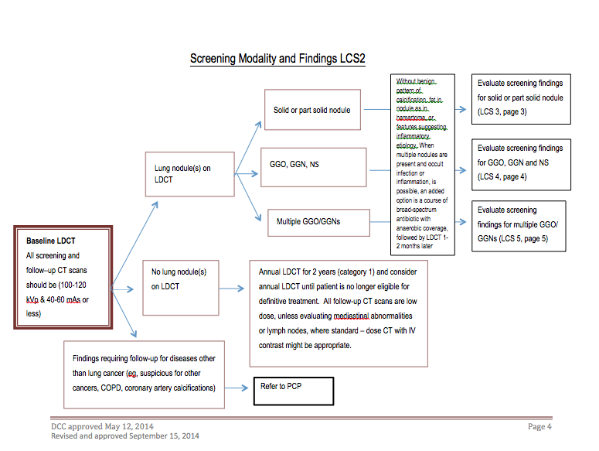
Screening findings

Slide 23
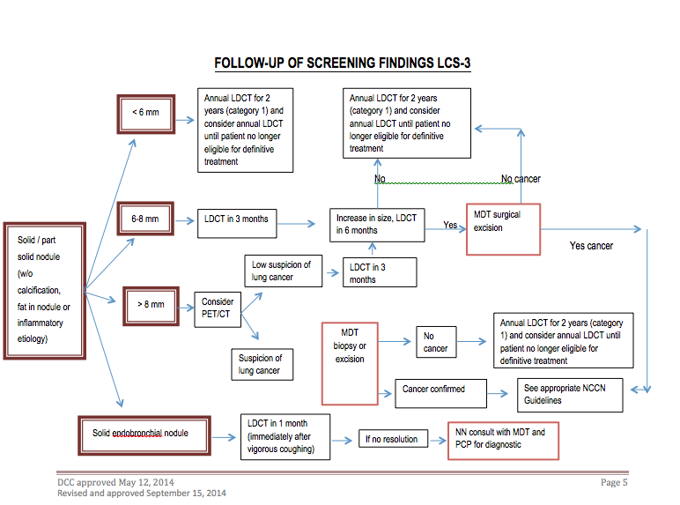
Follow UP of screening findings

Slide 24
Lung Screening Program Status
Radiology Contracted at Christiana Care, Bay Health, Beebe
    Plan to expand to other sites in coming years
Multidisciplinary Teams at the same institutions
Single State Wide Nurse Navigator (NN)
    Coordination with each site
Data Collection by NN and Storage at I-ELCAP
Marketing by AB&C starting April, 2015
Enroll First Client April, 2015.

Slide 25
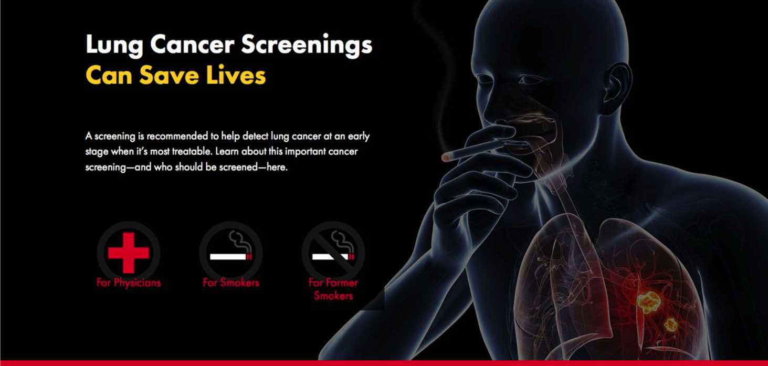
Marketing Campaign

Slide 26
Optimal lung screening program
Provide comprehensive patient centered program
Designed to maximize benefit and minimize harm
Characteristics:
    Rigorous procedures to ensure only high risk individuals are screened
    Shared decision making to decide on individual benefit of screening
    Integration of smoking cessation
    Comprehensive multidisciplinary process for screening and management (MDT)
    Maintenance of a registry
Weiner, RS
Annals of Internal Medicine 9/16/14, 445-446

Slide 27
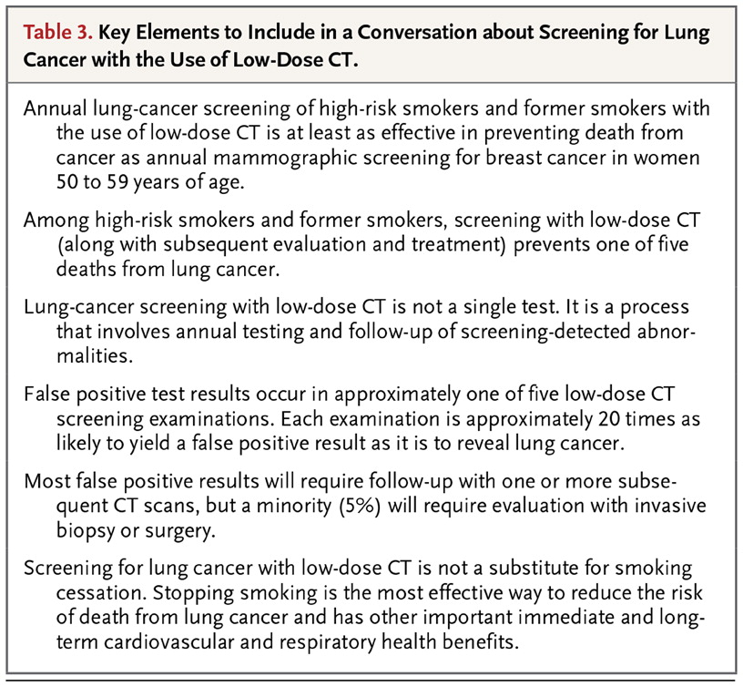
Gould MK. N Engl J Med 2014; 371:1813-1820.
Key Elements to Include in a ConversatiScreening for Lung Cancer with the Use of Low-Dose CT.

Slide 28
MEDicare Evidence and Coverage Advisory Committee (MEDCAC) 4/30/2014
Trial Demographics (25%>65, None >74)
CT false positives increase with age
Increased procedure complication rates with age
Increased post operative mortality with age
Over testing and over treatment
Benefit of life extension by screening decreases with age secondary to comorbidities
Benefit < Harm

Slide 29
Current National Landscape
USPSTF Grade B (ACA requires private Insurance coverage in 2015)
Endorsed by ACS, ASCO, American College of Chest Physicians, American Thoracic Society, NCCN, American Association of Thoracic Surgery, American College of Radiology
American Academy of Family Practice: Insufficient data to recommend for or against (1/11/2014)
CMS positive coverage determination 2/5/2015

Slide 30
Lung Screening by Low Dose CT (LDCT)
Eligibility for Screening | CMS | DE
Age | 55-77 | 55-80
Smoked > 30 Pack Years | X | X
Current or quit < 15 years | X | X
No Recent CT or Symptoms of Lung CA | X | X
Written Order for LDCT | X | X
Counseling and Shared Decision Documentation | X | X
Smoking Cessation Counseling & Intervention | X | X

Slide 31
Lung Screening by Low Dose CT (LDCT)
Radiology | CMS | DE
LDCT with standard CT dose index | X | X
Standardized Nodule Classification & Reporting | X | X
Board Certified Radiologist & ACR Continuing Education | X | X
Radiologist with Chest CT Experience | X | X
Submit CT Data to Registry | X | X

Slide 32
Lung Screening by Low Dose CT (LDCT)
Management | CMS | DE
Nurse Navigator |  | X
Primary Care Communication |  | X
Multidisciplinary Teams |  | X
Management Algorithms |  | X
Underserved Populations & Disparity Elimination |  | X
Effective Marketing |  | X
State Wide Analytics & Reporting |  | X

Slide 33
DE Lung Cancer Screening potential
Estimated 32,000 Eligible for screening
2786 Lung Cancer Deaths from 2006 to 2010
557 deaths annually
Screening can reduce mortality by 20%
Potential of 111 annual deaths avoided

Slide 34
Lung screening recent literature
Issues with implementing a High Quality Lung Cancer Screening Program. Mulshine JL; D’mico, TA. CA: A Journal for Clinicians; Vol 64(5); 9/2014; 352-363.
Lung Cancer screening. Davis,AM, Cifu AS. JAMA; Vol 312(12); 9/24/2014; 1248-1249.
Balancing the Benefits and Harms of Low Dose CT Screening for Lung Cancer: Medicare’s Options for Coverage. Weiner RS. Annals of Internal Medicine; Vol 161 (6); 9/16/14; 445-446.
Lung Cancer Screening with Low Dose CT. Gould MK: NEJM Vol 371; 11/6/2014; 1813-1820.

Slide 35
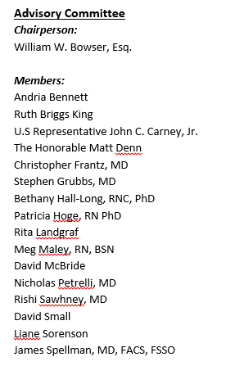
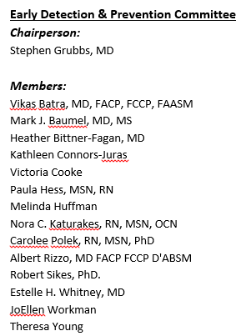
2015 DE Cancer Consortium & Early Detection and prevention Committee
DCC Advisory Committee EDPC

Slide 36
A special thanks
Nora Katurakes
    Christiana Care Community Health Outreach & Education
  Teresa Gallagher
    Director SFL, DE Division of Public Health
  Heather Brown
    DE Division of Public health

Slide 37
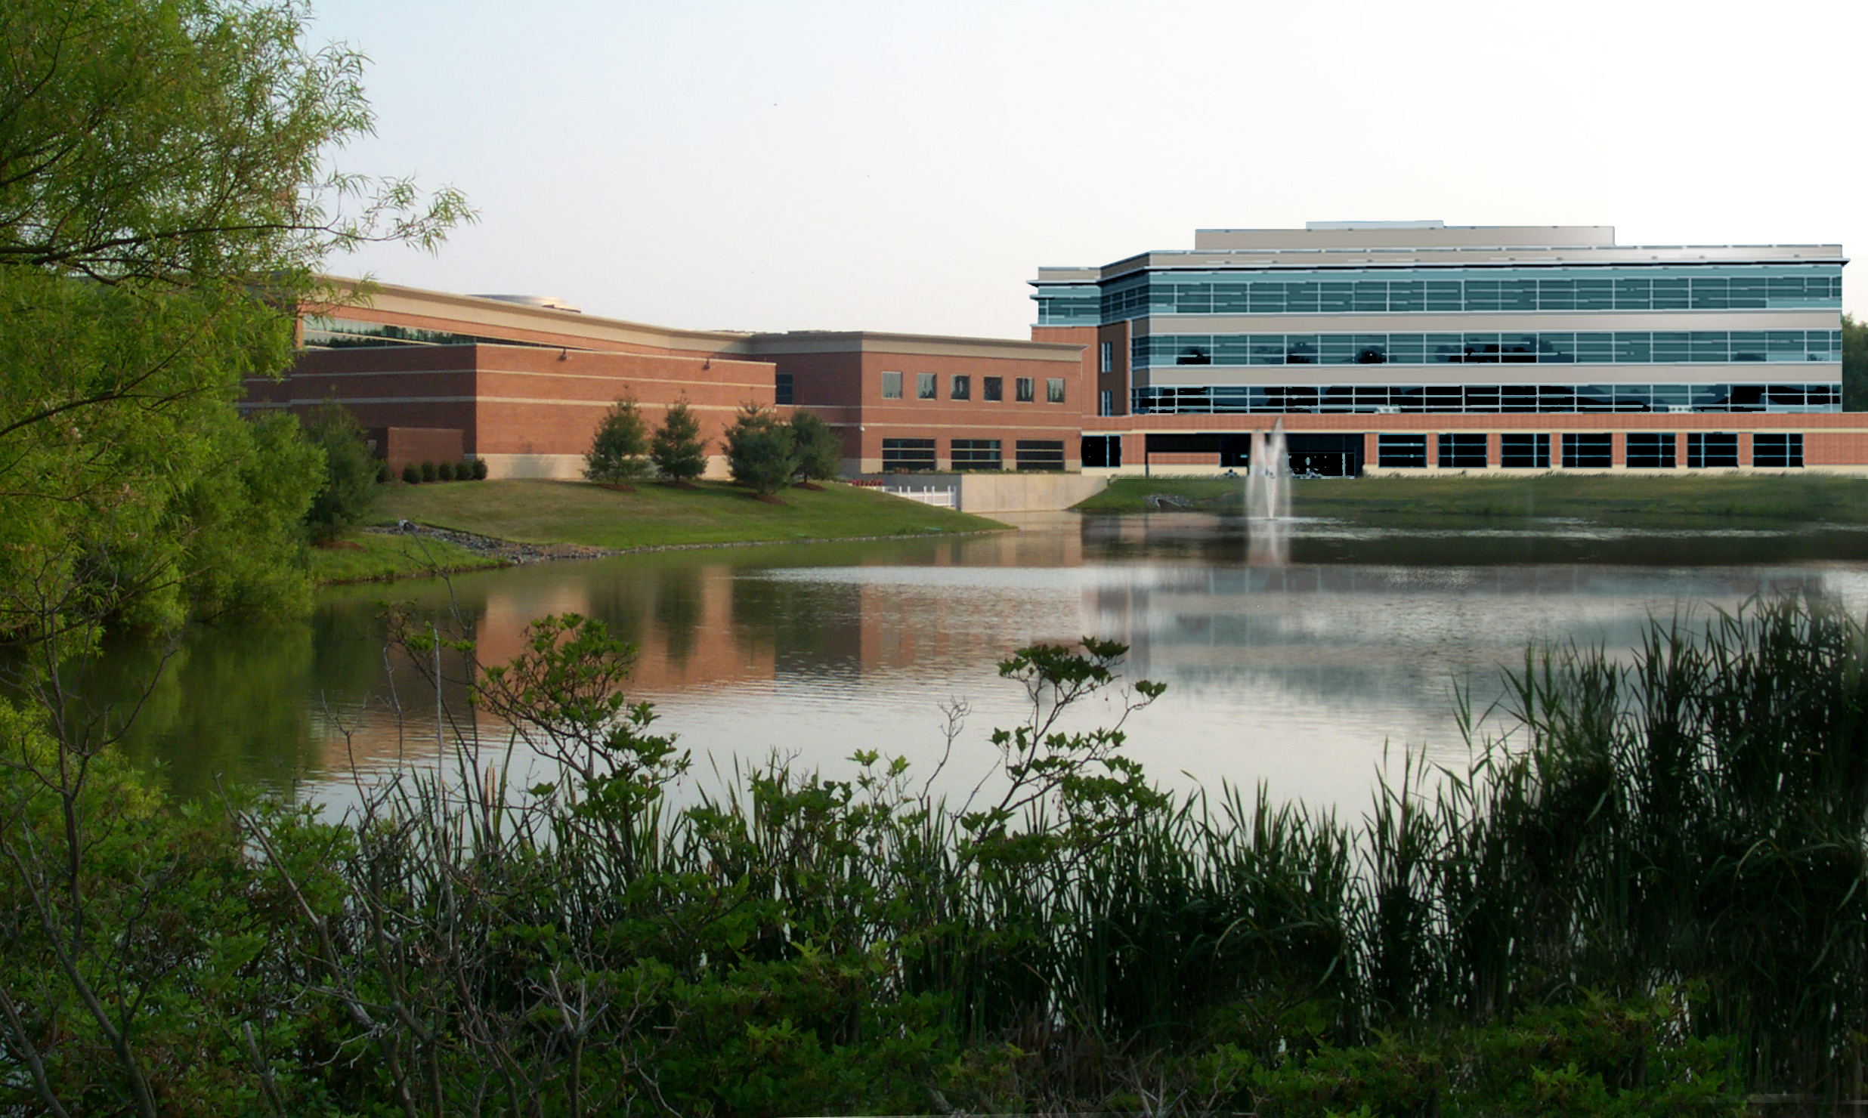
Helen F. Graham Cancer Center
& Research Institute
RESEARCH CURES CANCER
Newark, Delaware

