Slide 1
Cancer Survivor Transitions: Continuum of Care Standards
Nina Miller, MSSW, OSW-C
Commission on Cancer
Chicago, IL

Slide 2
The Commission on Cancer (CoC) is a consortium of professional organizations dedicated to improving survival and quality of life for cancer patients through standard-setting, prevention, research, advocacy, education, and the monitoring of comprehensive quality care.

Slide 3
Commission on Cancer Objectives
Establish standards to ensure quality, multidisciplinary, patient-centered and comprehensive cancer care delivery
Conduct surveys in healthcare settings to assess compliance with those standards
Collect standardized, high quality data from CoC-accredited facilities to measure cancer care quality
Use data to monitor treatment patterns and outcomes and enhance cancer control and clinical surveillance activities
Develop educational interventions to improve cancer prevention, early detection, care delivery, and outcomes

Slide 4
Patient-Centered Care
respecting the values, preferences and expressed needs of patients
coordinating & integrating care across system boundaries
providing the information, communication, and education that people want and need
promise of physical comfort, emotional support, and involvement of family and friends
Crossing the Quality Chasm: A New Health System for the 21st Century Institute of Medicine March 2001

Slide 5



Cancer Care Continuum – Survivor Transitions
PRIMARY CARE
RECOVERY/ SURVIVORSHIP
PREVENTION
SCREENING
DIAGNOSIS
TREATMENT
END-OF-LIFE CARE
PSYCHOSOCIAL & PALLIATIVE CARE
TARGETED NAVIGATION BASED ON NEED

Slide 6
Standard 3.1: Patient Navigation Process
identify the needs of the population
determine potential to reduce cancer disparities guide patients through care transitions to improve outcomes
identify barriers to care and the resources to address them
provide resource information to all and
work on resource gaps
Notes:
Population definition: interests of medically underserved populations, low income persons, minority groups, individuals with chronic disease and other conditions/needs. Define by geographic location or populations service and/or the principal functions or mission of the facility e.g. all with cancer or heart disease.

Slide 7
Cancer Care Continuum – Survivor Transitions
PRIMARY CARE
RECOVERY/ SURVIVORSHIP
PREVENTION
SCREENING
DIAGNOSIS
TREATMENT
END-OF-LIFE CARE
PSYCHOSOCIAL & PALLIATIVE CARE
TARGETED NAVIGATION BASED ON NEED
DISTRESS SCREENING

Slide 8
Standard 3.2 Psychosocial Distress Screening
Psychosocial Distress Screening is a brief method for prospectively identifying and triaging cancer patients at risk for illness-related psychosocial complications that undermine
their ability to fully benefit from medical care,
the efficiency of the clinical encounter,
satisfaction and safety
Identify patients in need of further assessment – referral - intervention from psychiatry, mental health professionals, social workers, counselors, pastors

Slide 9
Cancer Care Continuum – Survivor Transitions
------------------------HEALTH LITERATE, ACTIVATED PATIENT & FAMILY ------------------------
PRIMARY CARE
RECOVERY/ SURVIVORSHIP
PREVENTION
SCREENING
DIAGNOSIS
TREATMENT
END-OF-LIFE CARE
PSYCHOSOCIAL & PALLIATIVE CARE
TARGETED NAVIGATION BASED ON NEED
DISTRESS SCREENING

Slide 10
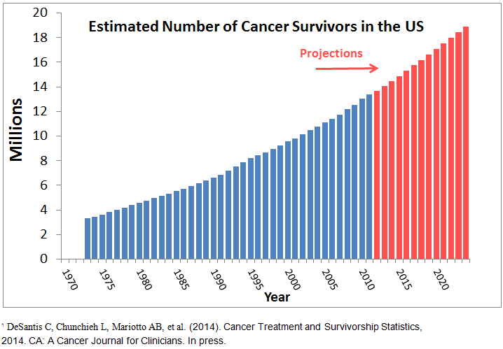
As of January 2014, it is estimated that there are 14.5 million cancer survivors in the United States representing over 4% of the population.
The number of cancer survivors is projected to increase by 31%, to almost 19 million, by 2024, representing an increase of more than 4 million survivors in 10 years.
“Primary care providers will need to play an expanding role in the early detection of cancer, as well as the follow-up, health promotion, and cancer surveillance…necessary after initial cancer treatment.” P. Ganz, M.D., UCLA

Slide 11

IOM 2006: From Cancer Patient to Cancer Survivor: Lost in Transition
IOM: “Patients completing primary treatment should be provided with a comprehensive care summary and follow-up plan written by the principal provider(s) who coordinated oncology treatment. The content of the plan should be reviewed with the patient during a formal discharge (end of treatment) consultation. “

Slide 12
“Cancer care plans are roadmaps that make sure you know where you are going and how you will get there.”
National Coalition for Cancer Survivorship

Slide 13
“Today, most oncology practitioners recognize the need to consider cancer’s long-term impact on their patients’ overall health and function. However, how best to do this remains a challenge. The evolving mandate to develop survivorship care plans, inclusive of plans to address psychosocial needs and provision of counsel about health promotion, presents a unique opportunity for advancing an integrative model of cancer care for those entering this new phase.”
Survivorship Care Planning: Unique Opportunity to Champion Integrative Oncology? By Julia H. Rowland and Ann O’Mara, Office of Cancer Survivorship, Division of Cancer Control and Population Sciences (JHR) and Division of Cancer Prevention (AO), National Cancer Institute, National Institutes of Health, Bethesda, MD
J Natl Cancer Inst Monogr (2014) 2014 (50): 285. doi: 10.1093/jncimonographs/lgu037

Slide 14
Late Effects
“…cancer and its treatment have the capacity to affect not simply physical well-being, but also virtually every aspect of an individual’s life, including psychological, social, economic and existential health and function. While some of these effects dissipate rapidly once treatment ends, others can persist over time, in some cases, becoming chronic. Still another set of effects may appear months or years after treatment ends, the most worrisome of these being recurrent or second cancers.”
Survivorship Care Planning: Unique Opportunity to Champion Integrative Oncology? By Julia H. Rowland and Ann O’Mara, Office of Cancer Survivorship, Division of Cancer Control and Population Sciences (JHR) and Division of Cancer Prevention (AO), National Cancer Institute, National Institutes of Health, Bethesda, MD
J Natl Cancer Inst Monogr (2014) 2014 (50): 285. doi: 10.1093/jncimonographs/lgu037

Slide 15

Delaware Cancer Consortium 2012-2016 Plan
“We will establish best practices for the transition of care so patients can feel confident in knowing the facts about the treatment they have received and recommendations for their continued care and that nothing will ‘fall through the cracks’ if and when it’s time for their primary care doctor to manage their care.”
“A seamless transition from provider to provider is vital to maximizing outcomes and quality of life.”

Slide 16
Standard 3.3 Survivorship Care Plan
The cancer committee develops and implements a process to disseminate a comprehensive care summary and follow-up plan to patients with cancer who are completing cancer treatment.
The process is monitored, evaluated, and presented at least annually to the cancer committee and documented in minutes.

Slide 17
3.3 Process Requirements
A survivorship care plan is prepared by the principal provider(s) who coordinated the oncology treatment for the patient with input from the patient’s other care providers.
The survivorship care plan is given to the patient on completion of treatment.

Slide 18
Standard Clarification – 9/14
Clarification of ‘patients with cancer who are completing cancer treatment’
Standard 3.3 is focused on the subset of survivors who are treated with curative intent, and have completed active therapy (other than long-term hormonal therapy).
This includes patients with cancer from all disease sites.
Patients with metastatic disease, though survivors by definition, are not targeted for delivery of comprehensive care summaries and follow-up plans under Standard 3.3.

Slide 19
3.3 Process Requirement
The written or electronic survivorship care plan contains a record of care received, important disease characteristics, and a follow-up care plan incorporating available and recognized evidence-based standards of care, when available.

Slide 20
Essential Elements
September, 2011:
LIVESTRONG convened the Essential Elements of Survivorship Care Meeting in Washington, DC.
Goal: build consensus among key stakeholders on the essential elements of survivorship care
UPDATE November 2012:
The LIVESTRONG Foundation and the LIVESTRONG Survivorship Center of Excellence Network refined the definitions of the 20 Essential Elements including specific recommendations and examples of basic and enriched levels of survivorship care

Slide 21
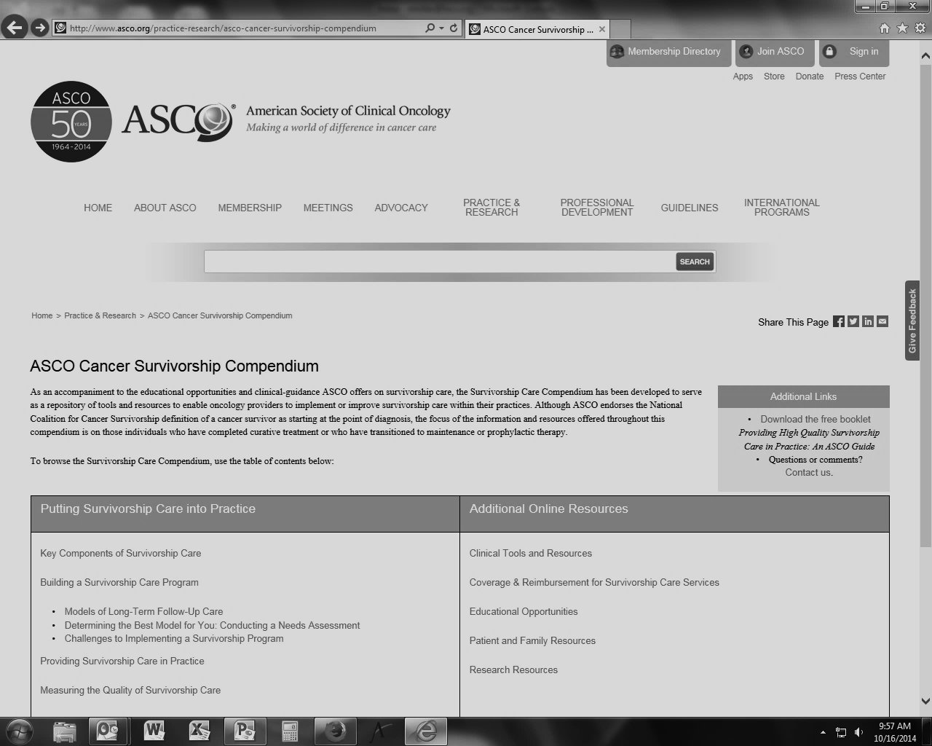
http://www.asco.org/practice-research/models-long-term-follow-care
Key Components of Survivorship Care

Slide 22
TREATMENT SUMMARY Core Elements
Contact information of the treating institutions and providers
Specific diagnosis (e.g. breast cancer), including histologic subtype (e.g. non-small cell lung cancer) when relevant
Stage of disease at diagnosis (e.g. I-III)
Treatment
Surgery (yes/no). If yes,
a. Surgical procedure with location on the body
b. Date(s) of surgery (year required, month optional, day not required)
Chemotherapy (yes/no). If yes,
a. Names of systemic therapy agents administered (listing individual names rather than regimens)
b. End date(s) of chemotherapy treatment (year required, month optional) Radiation (yes/no). If yes,
c. Anatomical area treated by radiation
d. End date(s) of radiation treatment (year required, month optional, day not required)
Ongoing toxicity or side-effects of all treatments received (including those from surgery, systemic therapy and/or radiation) at the completion of treatment. Any information concerning the likely course of recovery from these toxicities should also be covered.
For selected cancers, genetic/hereditary risk factor(s) or predisposing conditions and genetic testing results if performed

Slide 23
FOLLOW-UP CARE PLAN Core Elements
Oncology team member contacts with location of the treatment facility
Need for ongoing adjuvant therapy for cancer
a. Adjuvant therapy name
b. Planned duration
c. Expected side effects
Schedule of follow up related clinical visits
Cancer surveillance tests for recurrence
Cancer screening for early detection of new primaries
Other periodic testing and examinations
Possible symptoms of cancer recurrence
A list of likely or rare but clinically significant late- and/or long-term effects that a survivor may experience based on his or her individual diagnosis and treatment
A list of psychosocial items (e.g. emotional or mental health, parenting, work/employment, financial issues, and insurance)
A list of local and national resources to assist the patient obtain proper services
A general statement emphasizing the importance of healthy diet, exercise, smoking cessation and alcohol use reduction

Slide 24
Considerations when choosing a care plan
How much information the template includes
How easily staff or clinicians can walk patients through the document
The visual layout of the document
How easy it is to add patient information (e.g., whether the template includes any drop-down menus, if IT staff can save the template into the EMR)
Whether to use a general cancer or a tumor site specific template
If staff can embed educational information and related links into the care plan template, or if the template already contains such information
Whether it’s more convenient for plan creators to use a web-based or a locally stored template
Marisa Deline, 2014 Oncology Roundtable Philadelphia session - September, 2014

Slide 25






Survivor Care Guidelines Care Plan Templates
Notes:
National Comprehensive Cancer Network

Slide 26
From a Patient’s Perspective
Delivers basic information about diagnosis and treatment in one easily accessible space
Enhances communication with healthcare providers including primary care providers, specialty care providers, others unfamiliar with the patient’s history
Empowers patients to make informed decisions about prevention and screening for second cancers or recurrence
Provides information about potential symptoms of late effects or recurrence to facilitate early intervention
Helps determine the need for psychological distress assessment and care
Education, emotional support and tips on healthy lifestyles can improve physical and mental health

Slide 27
Outcomes and Satisfaction After Delivery of a Breast Cancer
Survivorship Care Plan: Results of a Multicenter Trial
Participants most commonly used SCP materials to make decisions about exercise (64%), which tests to receive and when (62%), and dietary changes (62%). Only 21% shared the SCP with their primary care provider during that time.
Satisfaction with the SCP was high, with 90% of participants reporting being at least satisfied with the SCP. Perceived knowledge about survivorship improved after SCP delivery, as did perceived care coordination and the provider’s knowledge of the effects of cancer on survivors (all P .001). Individuals closer to the time of diagnosis reported greater satisfaction with and use of SCPs.
Steven C. Palmer, PhD, et. al. JOP vol. 11, issue 2

Slide 28
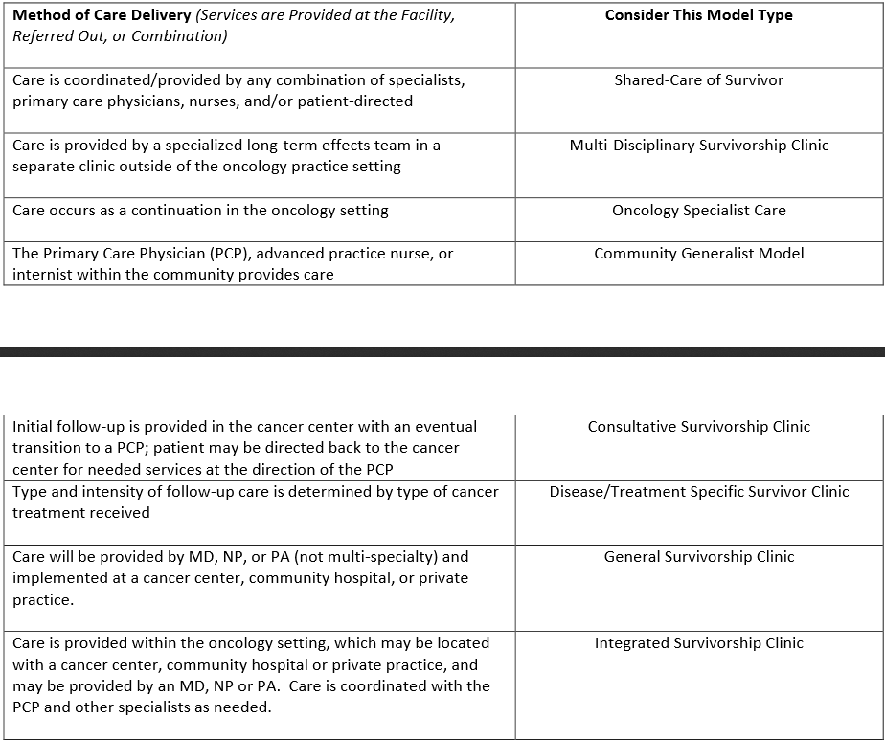
http://www.asco.org//practice-research/asco-cancer-survivorship-compendium Building a Survivor Care Program – Best Model Needs Assessment
Notes:
ASCO Needs Assessment with questions to help programs determine which of these survivor care models should be employed.

Slide 29
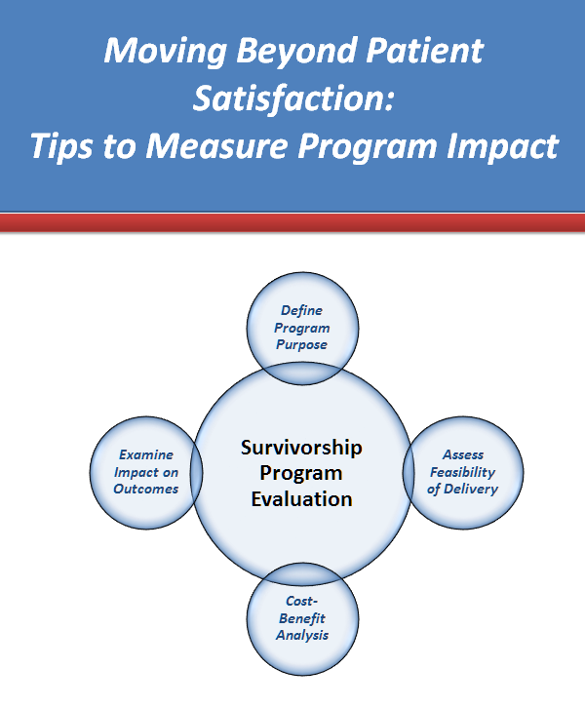
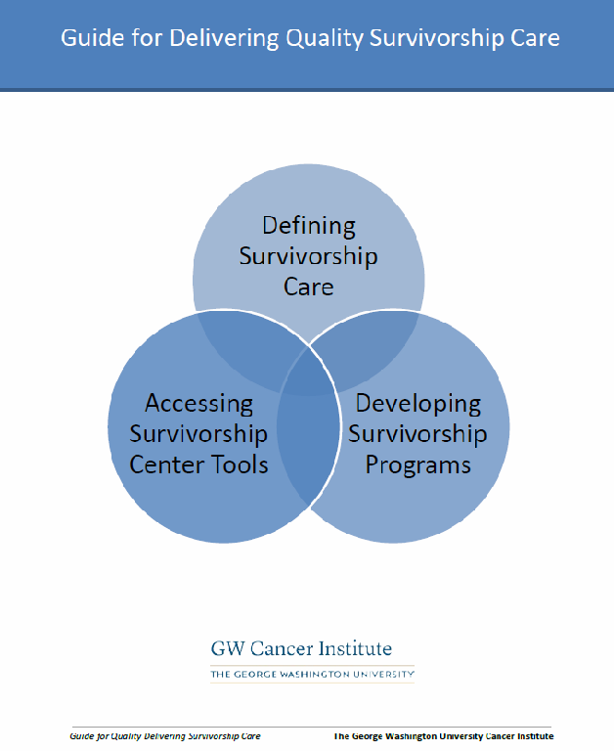
Moving Beyond Patient Satisfaction:
Tips to Measure Program Impact Guide cancer.org/survivorshipprogramevaluation
Program Development & Evaluation Resources
Guide for Delivering Survivorship Care
cancersurvivorshipcentereducation.org/Survivorship_Guide.html
NCI’s Research Tested Intervention Programs: http://rtips.cancer.gov/rtips/programSearch.do

Slide 30
Standard Clarification
It is recognized that models of health care and survivor care delivery vary. In the context of multidisciplinary care clinics the cancer committee should identify a physician team member or advanced practice partner who would be responsible for discussing the care plan with a patient.

Slide 31
Standard Clarification
When is standard 3.3 to be implemented?
During the implementation period, cancer programs should initially concentrate on their most common disease sites, such as breast, colorectal, prostate, early-stage bronchogenic, and lymphoma.
Cancer Programs that have fully implemented the Standard by the time of their on-site visit during the 2015, 2016, 2017 survey cycle, will receive special recognition in their Performance Reports at the time of their next survey.

Slide 32
When is Standard 3.3 to be implemented?
January 1, 2015 | Implement a pilot survivorship care plan process involving ≥ 10% of eligible patients.
January 1, 2016 | Provide survivorship care plans to ≥ 25% of eligible patients.
January 1, 2017 | Provide survivorship care plans to ≥ 50% of eligible patients.
January 1, 2018 | Provide survivorship care plans to ≥ 75% of eligible patients.
January 1, 2019 | Provide survivorship care plans to all eligible patients.

Slide 33
Conclusions, Thoughts & Considerations
Need for additional research on survivor care models
Need for additional work on the technology piece - extracting data for pre-populating treatment summaries
Need for additional outcomes research on the cost-benefit of the care plan
Patient reported outcomes research
Continued clarity of reimbursement for plan creation and delivery
Care passports or some type of standard of care for patients with metastatic disease
Ongoing work on follow-up care recommendations e.g. to help differentiate between late effect vs. recurrence
Continued research for health care management in cancer survivors

