Slide 1
Advancing Survivorship Care Through the National Cancer Survivorship Resource Center Nicole Erb, BA, Program Manager, The Survivorship Center Delaware Cancer Consortium Retreat, April 14, 2015
Notes:
Hello everyone. My name is Nicole Erb, and I am the program manager for The National Cancer Survivorship Resource Center which is based out of the American Cancer Society Corporate Center in Atlanta, Georgia.
Thank you for this opportunity to share The Survivorship Center activities to develop and disseminate evidence-based interventions and resources to improve care and quality of life of adult posttreatment cancer survivors.

Slide 2
Agenda
Survivorship definition & trends
Overview of The Survivorship Center
Cancer survivor & caregiver resources
Health care professional resources
Policy & advocacy resources
Next steps
Questions/comments
Notes:
Here is a look at what we will cover today. I will begin with a discussion of cancer survivorship, follow with an overview of The National Cancer Survivorship Resource Center tools and resources to support cancer survivorship programs, and then open-up for questions or comments.

Slide 3
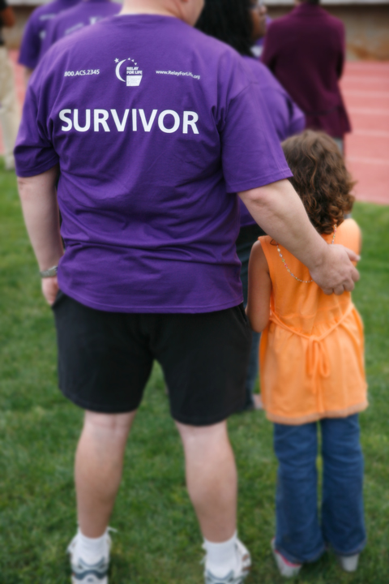
Who Are Cancer Survivors?
Any person who has been diagnosed with cancer, from the time of diagnosis through the balance of life
The term “survivor” is often used to mean someone who has completed active treatment
Notes:
(1:30-1:40p)
A cancer survivor is any person who has been diagnosed with cancer, from the time of diagnosis through the balance of life. There are at least three distinct phases associated with cancer survival, including the time from diagnosis to the end of initial treatment, the transition from treatment to extended survival, and long-term survival. In practice, the term “survivor” is often used to mean someone who has finished active treatment.
Nearly 14.5 million children and adults with a history of cancer were alive on January 1, 2014, in the United States. Factors driving growth of the survivor population include an aging US population whereas cancer is more common among older adults; improvements in early detection have led to finding cancers earlier when they are easier to treat; improvements in treatment options and improved clinical follow-up posttreatment have led to people living longer; and having access to cancer care has improved survival.

Slide 4
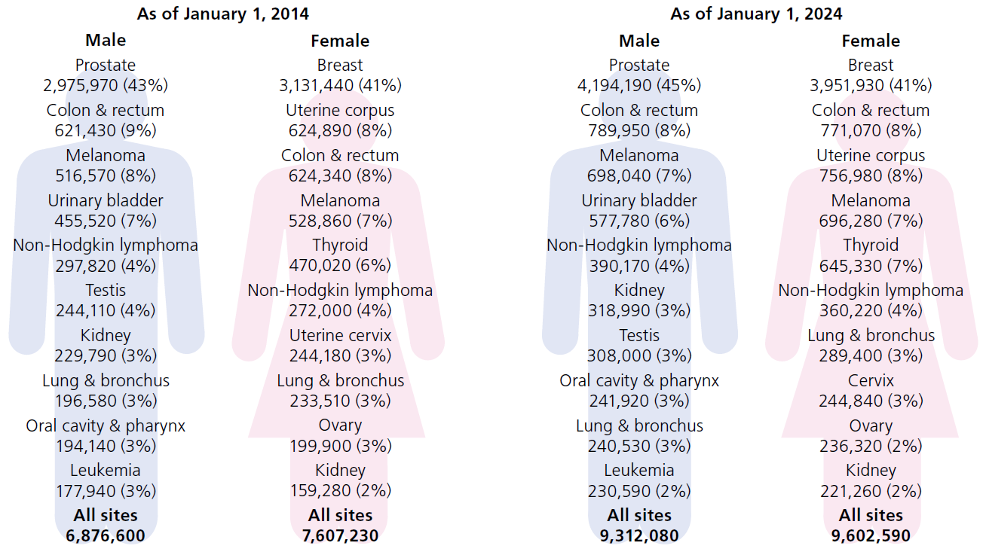
Estimated Numbers of US Cancer Survivors by Site
Notes:
This figure illustrates estimates for the 10 most common cancers among male and female survivors in 2014 and 2024. The most common cancer among male survivors is prostate cancer, followed by colorectal cancer and melanoma. Among female survivors, breast cancer is most common, followed by uterine and colorectal cancers.
The majority of cancer survivors (64%) were diagnosed 5 or more years ago, and 15% were diagnosed 20 or more years ago. Nearly half (46%) of cancer survivors are 70 years of age or older, while only 5% are younger than 40 years.

Slide 5
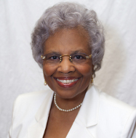
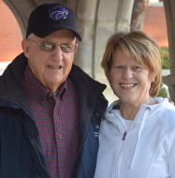
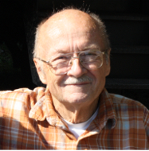
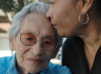
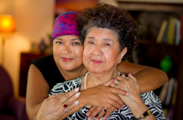
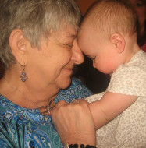

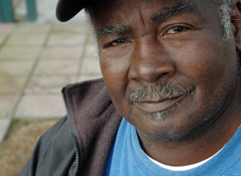
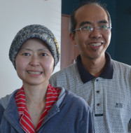
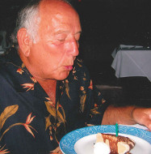
Range of Cancer Experiences
Living cancer-free for the remainder of life
Living cancer-free for many years but experiencing one or more serious, late complications of treatment
Living cancer-free for many years, but dying after a late recurrence
Living cancer-free after the first cancer is treated, but developing a second cancer
Living with intermittent periods of active disease requiring treatment
Living with cancer continuously without a disease-free period
Notes:
Survivorship encompasses a range of cancer experiences and trajectories, including: (read bullets)
The goals of treatment are to “cure” the cancer if possible and/or prolong survival and provide the highest possible quality of life during and after treatment. A cancer is cured when all traces of the cancer have been removed from the patient’s body. Although it is usually not possible to know for sure if the cancer has been completely eradicated, for many patients diagnosed with cancer, the initial course of therapy is successful and the cancer never returns. However, even cancer-free survivors must cope with the long-term effects of treatment, as well as psychological concerns such as fear of recurrence.
Cancer patients, caregivers, and survivors must have the information and support they need to play an active role in decisions that affect treatment and quality of life.

Slide 6
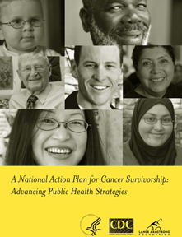


Seminal Publications in Cancer Survivorship
Notes:
(1:40-1:50p)
In 2004, the Centers for Disease Control & Prevention funded the Lance Armstrong Foundation to assess the needs of cancer survivors and develop a National Action Plan for Cancer Survivorship. That publication was soon followed by two Institute of Medicine reports. The Lost in Transition report outlined the primary issues facing cancer survivors and identified the “Essential Elements of Care” necessary to meet the needs of cancer survivors. Cancer Care for the Whole Patient provided an in depth look at the psychosocial issues faced by cancer survivors and outlined the necessary steps to assess and treat these issues to improve the quality of care provided to cancer patients and survivors.
The CDC recognized the relevance of these publications and noted there were few nationwide efforts aimed at addressing cancer survivorship and establishing the important role cancer survivorship plays in public health. In 2010, the CDC released a funding announcement to continue work toward implementing the Action Plan set forth in 2004.
Recognizing the American Cancer Society’s demonstrated success in the delivery of information and resources to cancer survivors, caregivers, and care providers, combined with cancer survivorship research expertise, a strong history in the development of clinical practice guidelines for the early detection of cancer, and the ability to impact both private and public policy, in 2010 the CDC awarded The Society a five-year cooperative agreement, a collaboration between the ACS and The George Washington University Cancer Institute, to develop the National Cancer Survivorship Resource Center or The Survivorship Center. This agreement included a plan to leverage the existing collaborative relationship with GW. GW had demonstrated expertise in the development of a survivorship clinic for childhood cancer survivors and a unique longitudinal approach to patient navigation. Additionally, GW’s strong presence in clinical care and education of patient navigators and care providers uniquely positioned them to collaborate with the ACS to achieve the goals and objectives of The Survivorship Center.
The Survivorship Center’s goal is to shape the future of adult posttreatment cancer survivorship care and to improve the quality of life of adult posttreatment cancer survivors.

Slide 7
Socio-Ecological Model: A Framework for Survivorship
Society / Policy Level
Health Care System Level
Cancer Survivor Level
Notes:
The Survivorship Center embraced a framework for its activities based on the socio-ecological model.
The cancer survivor level is aimed at addressing the needs of cancer survivors and their caregivers or individuals, the health care system level to impact care providers and the systems in which they work, and the society/policy level to address issues like reimbursement, research and advocacy.

Slide 8
Recommendations to Address Posttreatment Survivorship
Population | Recommendations
Survivors | Refinement of chronic disease self-management model for cancer survivorship to help empower survivors to manage their survivorship care Develop evidence-based, culturally appropriate information and resources to meet the needs of posttreatment survivors Increase awareness of existing survivorship information and resources
Health Care Systems | Develop survivorship care guidelines for clinical and psychosocial needs Routine provision of survivorship care plans Education & training of health care professionals
Society / Policy | Reimbursement for essential posttreatment survivorship care Funding for survivorship research to increase evidence base Education of policy makers to increase awareness of survivorship issues
Notes:
In Year 01, The Survivorship Center convened a panel of more than 130 experts representing more than 50 organizations nationwide.
Under the direction of a core team of project staff representing ACS, GW, CDC, and steering committee leadership, four expert panel workgroups worked to identify gaps in adult posttreatment cancer survivorship, develop recommendations to address the gaps, and identify performance indicators by which to measure progress.
While each workgroup focused on specific issues of the socioecological model, there was consistency in strategic recommendations across workgroups.
Key recommendations included:
refine and implement the chronic disease self-management model to address the needs of adult posttreatment cancer survivors
fill gaps in information and programmatic resources
develop clinical follow-up care guidelines
address gaps in care provider education
and develop policies that enhance the evidence-base and support the provision of high quality, timely care of cancer survivors.
Today I will provide an overview of the resources The Survivorship Center has developed to address all three levels of the socio-ecological model.

Slide 9
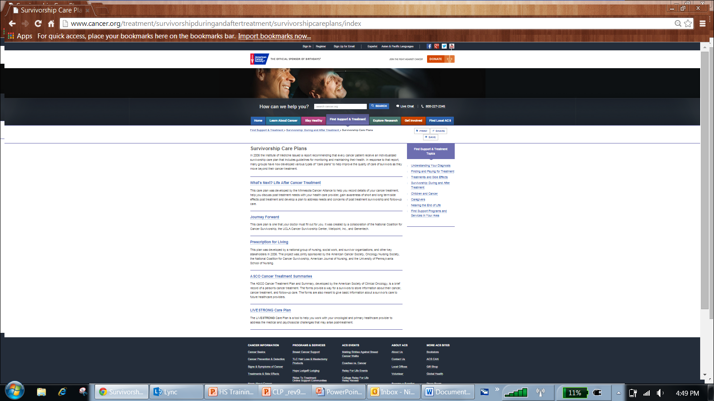
The American Cancer Society Website cancer.org/treatment/survivorshipduringandaftertreatment/index
Notes:
To locate Society survivorship resources, visit cancer.org/treatment/survivorshipduringandaftertreatment/index to access survivorship resources to address topics from nutrition and physical activity to online communities and support, in addition to survivorship care plan templates listed in the American Cancer Society-Commission on Cancer Collaborative Action Plan Guide.

Slide 10
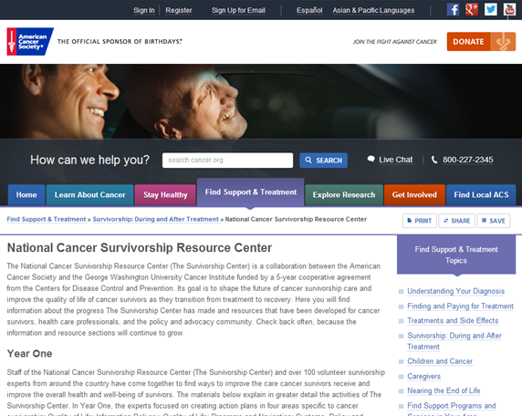
The Survivorship Center Website cancer.org/survivorshipcenter
Notes:
A survivorship resource listed on the previous web page is The Survivorship Center. Visit The Survivorship Center’s page at cancer.org/survivorshipcenter to learn more about The Survivorship Center’s strategic initiatives and to access resources for cancer survivors, health care professionals, and the policy and advocacy community.

Slide 11
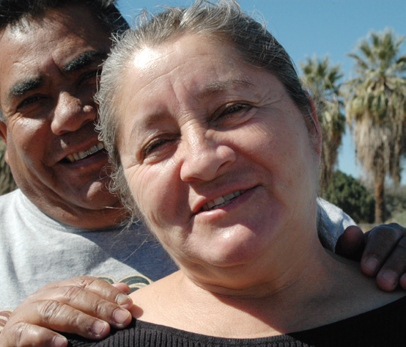

Notes:
(1:50-2:00p)
The Survivorship Center is working on the first level of the socioecological model to identify and develop resources to impact adult posttreatment cancer survivors and their caregivers.

Slide 12

Life After Treatment Guide cancer.org/survivorshipguide
Notes:
The Life After Treatment Guide is a quick, easy-to-read guide that helps cancer survivors and their caregivers understand the various aspects of the survivorship journey. The guide includes trusted resources for survivorship information and tips on how to communicate with care providers. Download a free copy at cancer.org/survivorshipguide or call the American Cancer Society at 1-800-227-2345 to request print copies.

Slide 13
Cancer Survivor Information Resource Inventory
 | Multimedia Only | Print Only | Both | Total
Healthy Habits | 92 | 20 | 15 | 127
Screening | 22 | 14 | 6 | 42
Genetic Counseling | 9 | 5 | 0 | 14
Physical Side Effects | 61 | 24 | 20 | 105
Psychosocial Issues | 75 | 16 | 22 | 113
Category Total | 259 | 79 | 63 | 401
Notes:
The Survivorship Center conducted, the Cancer Survivor Information Resource Inventory, an environmental scan of posttreatment survivorship information as a way to identify and analyze gaps in cancer information.
The Survivorship Center identified and searched the websites of 30 credible, national health organizations that provide information about cancer and conducted an Internet search using terms relevant to posttreatment cancer survivorship. The results of the two searches were combined and information was categorized as either multimedia or print.
In total, about 400 resources were identified. 259 of which were available through multimedia channels, though primarily online. 79 of which were available in print.
There is a clear gap in genetic counseling information across channels. Further investigation found this gap to be representative of the disparity of information in genetic counseling in general, this finding is not specific to genetic counseling for cancer. This is a relatively new field that is growing and research and expertise in this area is still developing.
The Survivorship Center plans to use the data collected to inform and build out the ACS Cancer Resource Connection to make the database more comprehensive and inclusive of posttreatment resources.

Slide 14
Chronic-Disease Self-Management Program Pilot
What is Self-Management?
Learning and practicing skills necessary to carry on an active and emotionally satisfying life in the face of a chronic condition.
(Kate Lorig, DrPH, Department of Medicine, Stanford University)
Self-management skills
Problem solving
Decision-making
Resource utilization
Forming partnerships with HCPs
Taking action
Self-management tasks
Managing the illness
Carrying out normal activities
Managing emotional changes
Notes:
End of treatment can be a difficult time for cancer survivors, who must learn how to manage treatment-related issues without frequent support of their care team. This shifts the cancer care paradigm to a chronic care model. It also offers the opportunity to apply the principles of the chronic care model, especially self-management.
One of the most widely used chronic disease self-management programs was developed at Stanford University. This program has been shown effective in improving health and health behaviors while reducing health care over-utilization.
The ACS with Stanford University and the National Council on Aging are piloting a self-management program for posttreatment cancer survivors called, Cancer: Thriving and Surviving.
Many survivors experience a myriad of long-term physical and psychosocial effects stemming from their cancer and its treatment, but there are few resources and programs available to help them manage their health and wellness after treatment.
A primary objective of The Survivorship Center’s work to increase evidence-based survivorship programs is to conduct a pilot of Stanford University’s Cancer: Thriving and Surviving web-based cancer self-management program. The program was adapted from the existing chronic disease self-management program developed by Stanford that is widely used throughout the US and internationally. The program is conducted in partnership with the National Council on Aging.
The specific aims of the pilot include exploring the feasibility of using unpaid ACS volunteers as facilitators, exploring effectiveness of various recruitment channels, and contributing to the evidence-base for cancer self-management programs.
Next steps include completion of the 12-month follow-up phase, in-depth qualitative and quantitative analyses, comparison of this data with other ACS survivorship studies where appropriate, and identification of and development of additional self-management resources to support survivors.

Slide 15


Notes:
(2:00-2:10p)
The Survivorship Center is working on the second level of the socioecological model to impact health care systems by developing cancer survivorship care resources for care providers, organizations, and communities.

Slide 16
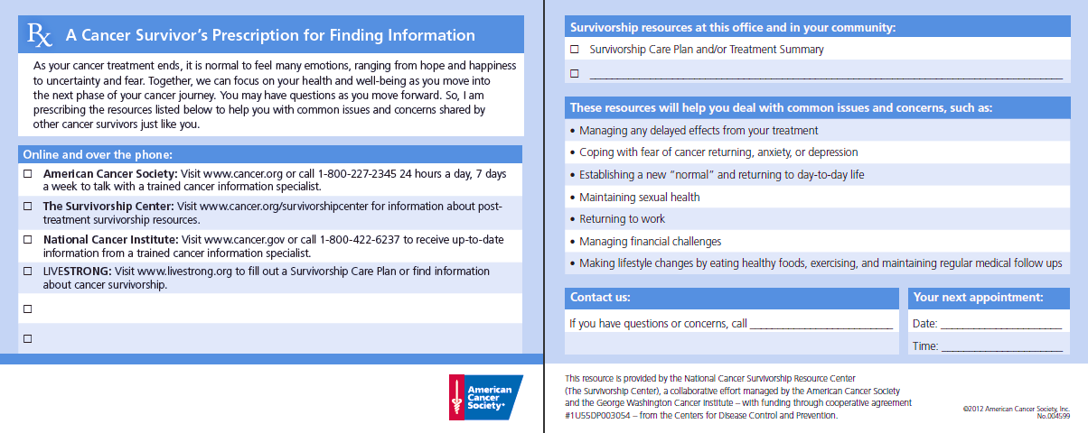
Prescription for Cancer Information cancer.org/survivorshipprescription
Notes:
The Prescription for Cancer Information is a tool to help care providers talk to survivors about resources available in their office or clinic, in the community, online, and over the phone. Download a free copy at cancer.org/survivorshipprescription or call the ACS 800 number to request print copies.

Slide 17
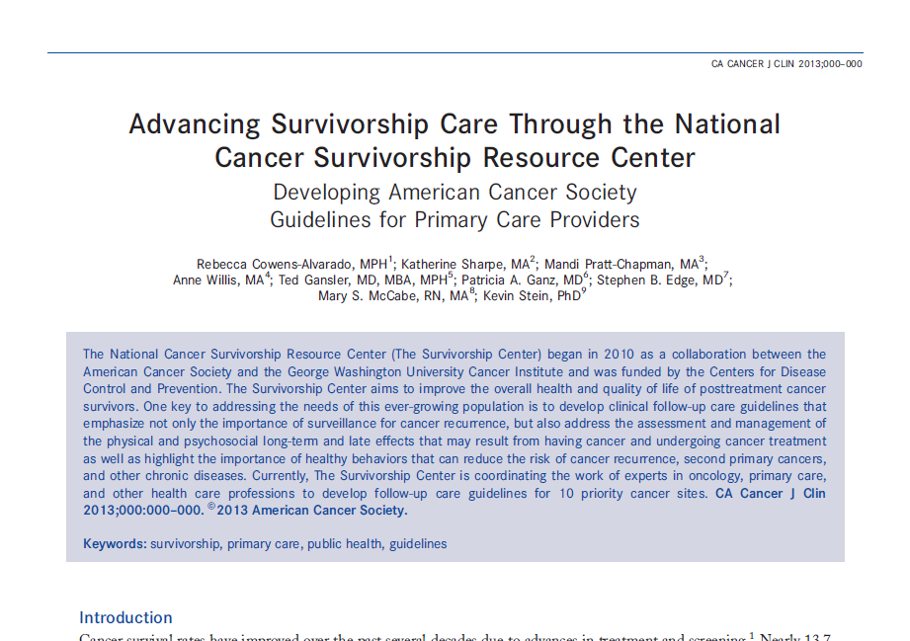
Developing American Cancer Society Guidelines for Primary Care Providers bit.ly/SurvivorshipCenter
17
Notes:
Another primary objective of The Survivorship Center’s work to increase evidence-based survivorship programs is to collaborate with key partners in the development of clinical follow-up care guidelines for primary care providers who care for adult posttreatment cancer survivors to expand the delivery of quality survivorship care.
The Survivorship Center is coordinating the work of experts in oncology, primary care, and other health care professions to develop clinical follow-up care guidelines.
The Survivorship Center identified 10 priority cancer sites for guideline development based on survivor prevalence and severity of long-term and late effects, and the evidence supporting the need for information and resources to guide primary care providers in caring for cancer survivors. The 10 sites are breast, colorectal, prostate, head & neck, gynecologic (including cervical, ovarian, endometrial and uterine), and lung and melanoma. Read this article at bit.ly/SurvivorshipCenter to learn more about the process.
The guidelines were created to provide clinical follow-up care standards to address health promotion, surveillance for recurrence and screening for new primary cancers, and assessment and management of physical and psychosocial long-term and late effects of cancer and its treatment.
The Survivorship Center targeted an audience of primary care providers, since they have established long-term relationships overseeing care and the management of medical and psychosocial problems posttreatment. After treatment ends and patients leave the oncology care setting, they turn to the PCP for routine care. The PCP may then face the burden of caring for the cancer survivor with limited knowledge of cancer treatment and its long-term or late effects.
The guidelines are intended to help shape an evidence-based standard of care for adult posttreatment cancer survivors, ensuring continued surveillance, delivery of preventive care and management of comorbid conditions, and management of long-term & late effects posttreatment.

Slide 18
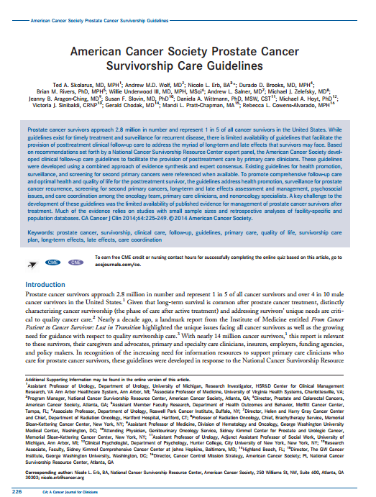
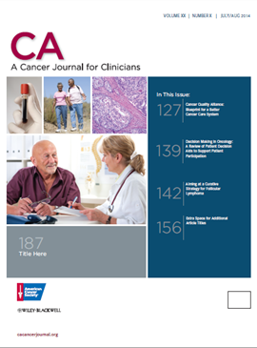
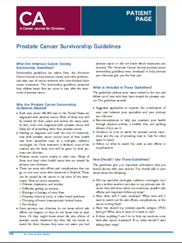
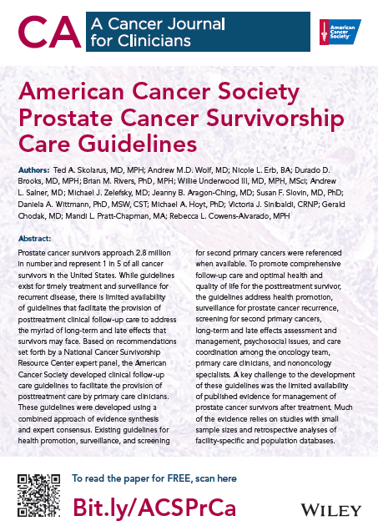
American Cancer Society Prostate Cancer Survivorship Care Guidelines bit.ly/ACSPrCa
Notes:
The first in the new ACS series of survivorship care guidelines, the ACS Prostate Cancer Survivorship Care Guidelines were published online in CA: A Cancer Journal for Clinicians in June 2014 and were featured in the Jul/Aug print issue.
To support survivorship care plan implementation, the article highlighted guidelines for survivorship care coordination and practice implications. The recommendations encourage treating specialists to provide survivorship care plans that include treatment summaries and posttreatment clinical follow-up care recommendations to the primary care clinician to help coordinate survivorship care; also encouraging primary care clinicians and treating specialists to confer regarding the survivorship care plan components and determine roles and responsibilities appropriate for the survivor’s condition and the resources available in the primary care setting. This section was also intended to increase awareness among primary care clinicians that while oncology providers are increasingly providing survivorship care plans as per the IOM recommendation, that new survivorship care planning accreditation requirements are being phased in by the American College of Surgeons Commission on Cancer. Also, to help support implementation and address barriers and opportunities, The Survivorship Center participated on a November 2014 ACS & CoC webinar, with speakers from the CoC and clinicians from CoC-accredited hospitals, as part of a discussion of best practices and lessons learned in implementation of the CoC Standard 3.3: Survivorship Care Plan, and to share The Survivorship Center and ACS resources to support survivorship programs and SCP implementation.
Visit bit.ly/ACSPrCa to access the free CA article (a care provider resource) and CA Patient Page (a survivor resource). The Publisher produced a marketing flyer to share with partners and collaborators that can be made available electronically upon request.
The breast and colorectal guidelines were approved by the ACS Board and the manuscripts are being finalized for journal submission this summer. Head & neck guidelines were recently approved by the ACS Board. Journal submission is anticipated in fall 2015.
(Note: We will be conducting a systematic review to determine if adequate published
evidence is available to develop the remaining guidelines, if not, we plan to submit
manuscripts outlining general survivorship considerations by cancer type where
evidence is available or develop position statements to issue a call for needed
research)

Slide 19
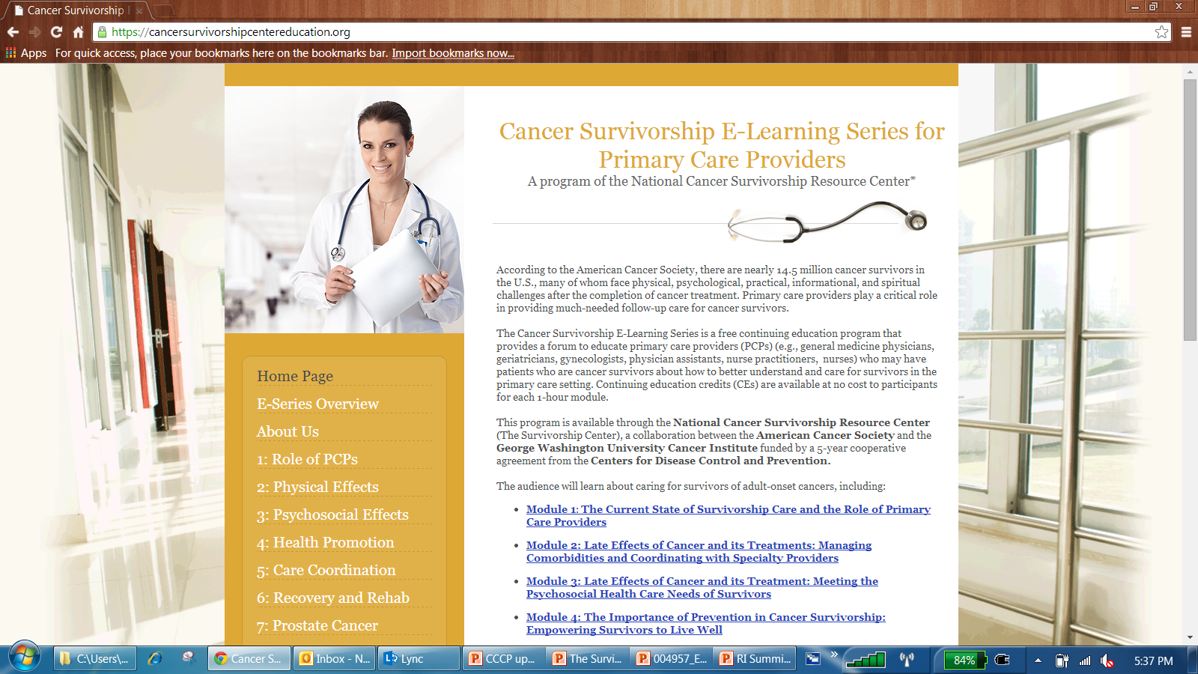
Cancer Survivorship E-Learning Series for Primary Care Providers cancersurvivorshipcentereducation.org
Notes:
The Cancer Survivorship E-Learning Series for Primary Care Providers is a free continuing education program that provides a forum to educate primary care providers (e.g., general medicine physicians, geriatricians, gynecologists, physician assistants, nurse practitioners, nurses) who may have patients who are cancer survivors about how to better understand and care for survivors in the primary care setting. Continuing education credits are available at no cost to participants for each 1-hour module.
The objectives of the Cancer Survivorship E-Learning Series for Primary Care Providers are to: 1) increase PCP awareness of the ongoing needs of cancer survivors, 2) increase PCP knowledge of how to care for cancer survivors, and 3) increase PCP ability to provide follow-up care for cancer survivors.

Slide 20
Cancer Survivorship E-Learning Series for Primary Care Providers cancersurvivorshipcentereducation.org
1: The Current State of Survivorship Care and the Role of Primary Care Providers
2: Late Effects of Cancer and its Treatments: Managing Comorbidities and Coordinating with Specialty Providers
3: Late Effects of Cancer and its Treatment: Meeting the Psychosocial Health Care Needs of Survivors
4: The Importance of Prevention in Cancer Survivorship: Empowering Survivors to Live Well
5: A Team Approach: Survivorship Care Coordination
6: Cancer Recovery and Rehabilitation
7: Spotlight on Prostate Cancer Survivorship: Clinical Follow-Up Care Guidelines for Primary Care Providers
Notes:
There are currently seven modules offered, including topics such as care coordination and cancer-type specific guidelines becoming available soon after they are published. The new Prostate Cancer Survivorship: Clinical Follow-Up Care Guidelines for Primary Care Providers module summarizes the potential long-term and late effects of prostate cancer and its treatment, describes how to care for prostate cancer survivors as outlined in the new ACS guidelines, and explains a primary care provider’s role in providing clinical follow-up care to prostate cancer survivors.
The series was designed for primary care providers, but oncology providers may also find benefit if seeking to increase their awareness and knowledge of the essential elements of survivorship care.

Slide 21
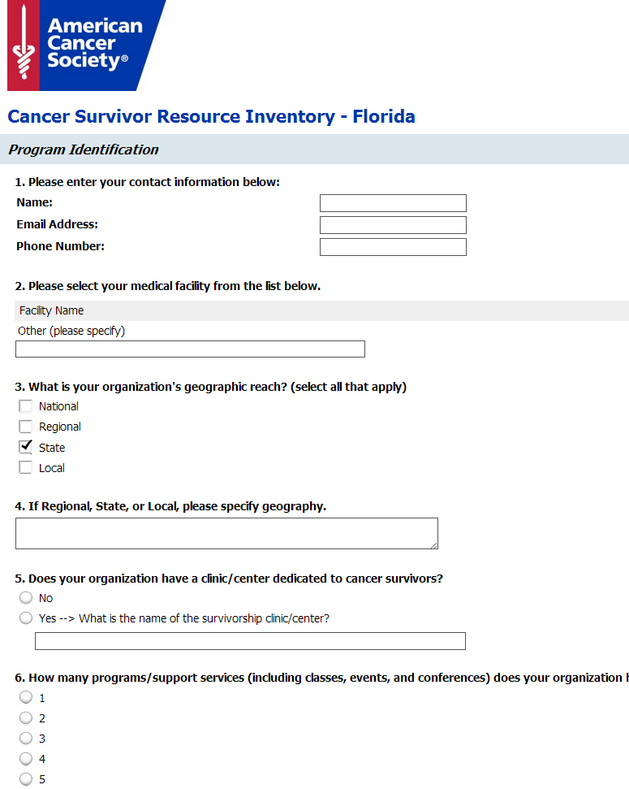
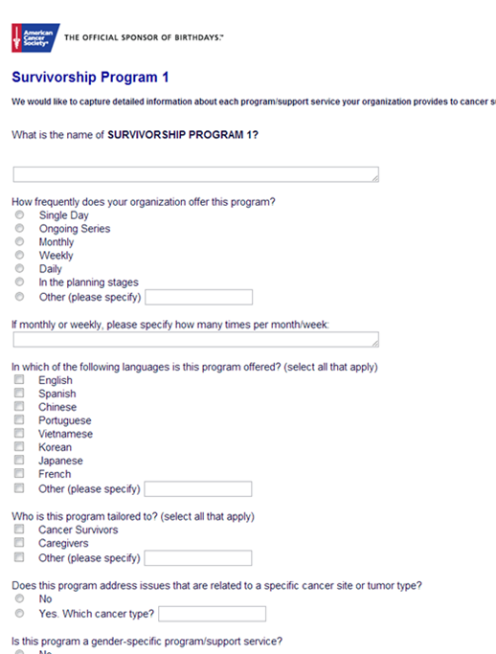
Cancer Survivor Program Resource Inventory
Notes:
To address the gap regarding limited information on the availability of programs for posttreatment survivors, The Survivorship Center developed the Cancer Survivor Program Resource Inventory.
This Survivorship Center research activity provided an opportunity to catalogue posttreatment survivorship resources among CoC-accredited facilities nationwide, to develop gap assessments for facilities to use in guiding their strategic priorities for program development or enhancement, as well to identify and share promising practices among programs.
Data captured in the survey included program identifiers such as facility name, geographic reach, whether the facility has a dedicated survivorship clinic; program information including frequency of the program offering, audience demographics (age, gender, cancer type, language), intervention type, topics covered, program delivery method, program setting, evaluation component and how the program is promoted.
The survey captured data from 490 CoC facilities in 45 states. You can reach out to CoC accredited facilities to learn more about program opportunities identified in surveys in Delaware.

Slide 22
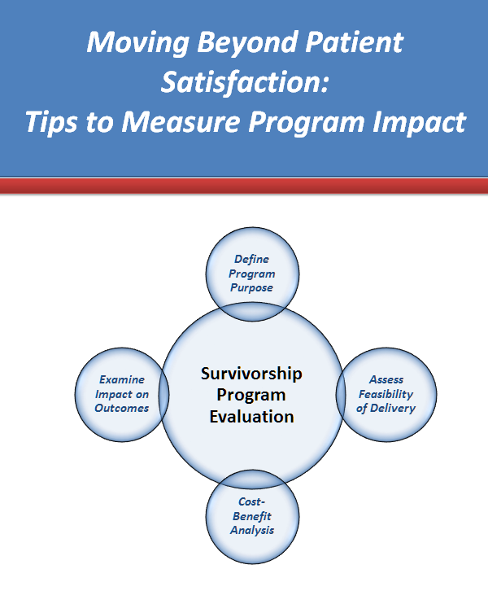
Moving Beyond Patient Satisfaction: Tips to Measure Program Impact Guide cancer.org/survivorshipprogramevaluation
Notes:
In an effort to address the gap in the lack of evidence on the effectiveness of survivorship programs, The Center developed The Moving Beyond Patient Satisfaction: Tips to Measure Program Impact Guide. The brief guide details indicators and outcome measures that can be used to monitor the success of survivorship programs. It highlights basic evaluation steps and is designed to assist program directors and managers when evaluating survivorship programs by recommending evidence-based measurement tools to show program impact on survivorship. Visit cancer.org/survivorshipprogramevaluation to download a free copy.

Slide 23
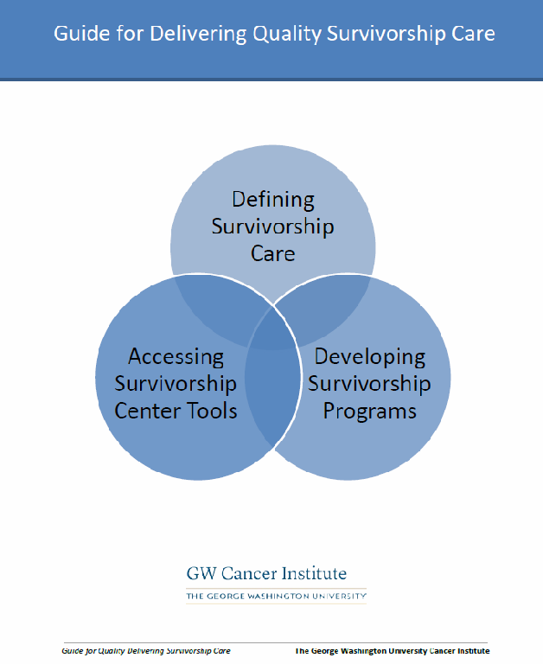
Guide for Delivering Survivorship Care cancersurvivorshipcentereducation.org/Survivorship_Guide.html
Notes:
Developed by The GW Cancer Institute as part of The Survivorship Center’s work, the Guide for Delivering Quality Survivorship Care provides health care professionals with the knowledge, tools, and resources to deliver high-quality follow-up care to cancer survivors. The Guide is divided into three sections: Defining Survivorship Care, Developing Survivorship Programs, and Accessing Survivorship Center Tools. The Guide will continue to be updated with the latest information, research, and evidence-based interventions.

Slide 24


Notes:
(2:10-2:15p)
The last level of the socio-ecological model focuses on the Society/Policy level. The Survivorship Center is working to develop cancer survivorship care resources for policy makers, decision makers, and cancer survivor advocates.

Slide 25
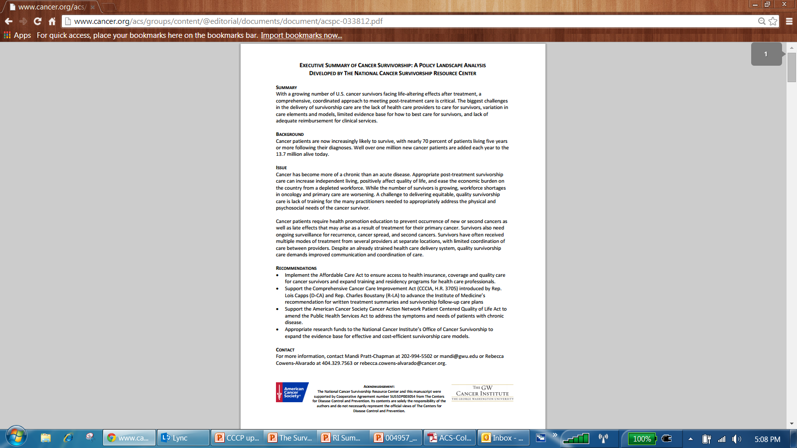
Cancer Survivorship: A Policy Landscape Analysis cancer.org/survivorshippolicypapers
Notes:
Policy change has the ability to impact the greatest number of cancer survivors. As the population of survivors rises to more than 14 million in the US, the urgency for policy change increases.
The Survivorship Center published, “Cancer Survivorship: A Policy Landscape Analysis,” a health policy paper which provides a broad overview of the issues impacting survivorship, covering topics such as the challenges in the delivery of survivorship care, the limited evidence base of how best to care for survivors, and the difficulty in reimbursing survivorship care services. The objective of the paper is to educate policy makers on survivorship issues and describe the priority areas for improving survivorship care. The paper is available for free download at cancer.org/survivorshippolicypapers.
A second policy paper highlighting survivorship as a public health priority is being completed for publication this fall.

Slide 26
Year 05 Activities
Recommend priority areas for information and program development
Complete evaluation of Cancer: Thriving and Surviving and develop recommendations for resources
Publish survivorship care guidelines and corresponding E-Learning Series modules
Expand care provider resources to facilitate utilization of survivorship care guidelines
Publish research findings
Evaluate activities
The Survivorship Center
Survivor
Health Care System
Policy
Research
Notes:
As The Survivorship Center closes out the last year of funding, next steps include:
… as gleaned from the Cancer Information and Program Resource Inventories and Chronic Disease Self-Management Program Pilot. Activities to include building out the ACS Cancer Resource Connection, a searchable online database of community cancer resources and programs, to increase referrals of posttreatment survivors by the ACS National Cancer Information Center and Patient Service Center to inventory resources.
… including a variety of self-management resources, for example, potential web-based or mobile applications for survivors.
… next up is colorectal, then breast, and then head & neck cancer sites.
… some of you may be aware that the CDC has issued a new survivorship FOA to be awarded to six CCCPs to implement a broad set of evidence-based survivorship strategies to increase survivor and care provider knowledge of survivorship care and guidelines. This collaborative cancer control effort will include the ACS and The Survivorship Center and the CCCP care provider and health systems networks and other relevant key partners, to address the public health needs of survivors with a goal of positively impacting survivor life expectancy and physical & psychosocial health-related quality of life. This activity will be one strategy for helping to expand The Survivorship Center program reach, support development, dissemination and implementation of survivorship care education and awareness resources, share best practices, and build survivorship care capacity within states. The Survivorship Center will work with states and their community and clinical partners to promote and disseminate The Survivorship Center cancer survivorship care resources and evidence-based interventions for survivors & caregivers and care providers, including many of the resources shared here today. It is my understanding that the DE CCCP is not planning to apply for the new CDC Survivorship RFA, but in the short-term the existing survivor and care provider resources from The Survivorship Center are available to this network, and long-term we may learn best practices from the six CCCPs that will be awarded to help other states build survivorship care capacity and share best practices for dissemination and implementation. The Survivorship Center continues to participate with state CCCPs (e.g., survivorship workgroups) to inform a national perspective, and support development of new or tailored local resources.
… from the chronic disease self-management program pilot to contribute to the existing evidence base for the program.
… as we close out the cooperative agreement.

Slide 27
The Survivorship Center Project Staff Contact Information
American Cancer Society
GW Cancer Institute
Principal Investigator/Project Director
Catherine Alfano, PhD
catherine.alfano@cancer.org
Program Manager
Nicole Erb, BA
nicole.erb@cancer.org
Behavioral Scientist
Rachel Cannady, BS
rachel.cannady@cancer.org
Research Analyst
Kerry Beckman, CHES, MPH
kerry.beckman@cancer.org
Program Coordinator
Patrice Bowles, BBA
patrice.bowles@cancer.org
Principal Investigator/Project Director
Mandi Pratt-Chapman, MA
mandi@gwu.edu
Sr. Project Manager
Anne Willis, MA
annewillis@gwu.edu
Project Manager
Shaira Morales
smorales@gwu.edu
Project Coordinator
Monique House, MS, CHES
mshouse@gwu.edu

Slide 28


Thank You
To learn more about The Survivorship Center,
Visit: cancer.org/survivorshipcenter
Email: survivorship@cancer.org
This presentation is supported by Cooperative Agreement #5U55DP003054 from The Centers for Disease Control and Prevention. Its contents are solely the responsibility of the authors and do not necessarily represent the official views of the Centers for Disease Control and Prevention.
Notes:
Be sure to visit The Survivorship Center web site to access resources, tools, and updates on all The Survivorship Center activities. Questions or comments can be emailed to survivorship@cancer.org.
Thank you for your time and attention.

Slide 29
Notes:
(2:15-2:20p)

