Slide 1

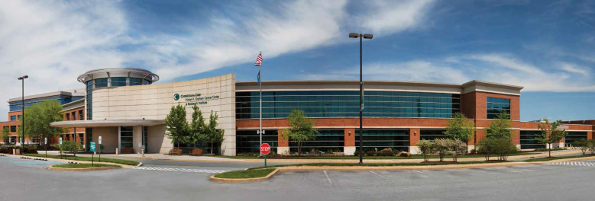
You can’t get there from here:
Getting the Survivorship Agenda Back on Track
Scott D. Siegel, Ph.D.
Licensed Psychologist
Director, Psychosocial Oncology & Survivorship
Helen F. Graham Cancer Center & Research Institute
Christiana Care Health System

Slide 2
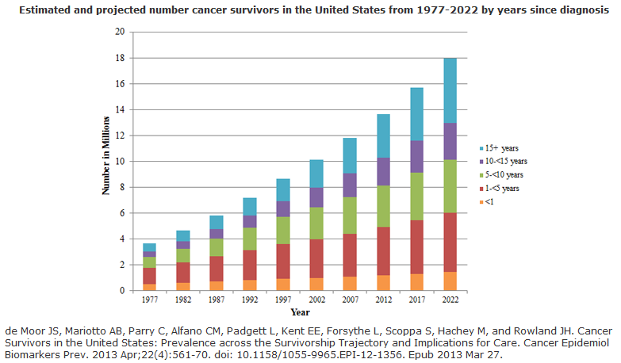

BOX ES-1
Essential Components of Survivorship Care
Prevention of recurrent and new cancers, and of other late effects;
Surveillance for cancer spread, recurrence, or second cancers; assessment of medical and psychosocial late effects;
Intervention for consequences of cancer and its treatment, for example: medical problems such as lymphedema and sexual dysfunction; symptoms, including pain and fatigue; psychological distress experienced by cancer survivors and their caregivers; and concerns related to employment, insurance, and disability; and
Coordination between specialists and primary care providers to ensure that all of the survivor’s health needs are met.

Slide 3
Outline:
Treatment Summaries/Care Plans
Feasibility?
Evidence-based?
Survivor-centered?
Innovation?

Slide 4
Is the treatment summary/care plan standard feasible?
I. Feasibility

Slide 5
Treatment Summary Requirements
Contact info of treating providers/institutions
Specific diagnosis, including histological subtype
Surgical procedures
Chemotherapy agents (listing individual names) & dates of treatment
Radiation treatment areas &dates of treatment
Ongoing toxicity/side-effects of treatment
Genetic/hereditary risk factor(s) or predisposing conditions and genetic testing results

Slide 6
Care Plan Requirements
Contact/location info for all providers where f/u required
Need for ongoing adjuvant therapy including adjuvant therapy name, planned duration, expected side effects
Schedule of f/u visits with names of providers, frequency, location
Cancer surveillance tests for recurrence including provider responsible for ordering, frequency of testing, location of testing
Cancer screening for early detection of new primaries
Other tests/examinations
Possible symptoms of recurrence
Likely and rare late- and long-term effects
A statement about health behavior

Slide 7
The fine print
Standard 3.3, though, is focused on the subset of survivors who are treated with curative intent, and have completed active therapy (other than long-term hormonal therapy). This includes patients with cancer from all disease sites.
Patients with metastatic disease, though survivors by some definitions, are not targeted for delivery of comprehensive care summaries and follow-up plans under Standard 3.3.
January 1, 2015 – Implement a pilot survivorship care plan process involving 10% of eligible patients.
January 1, 2016 – Provide survivorship care plans to 25% of eligible patients.
January 1, 2017 – Provide survivorship care plans to 50% of eligible patients.
January 1, 2018 – Provide survivorship care plans to 75% of eligible patients.
January 1, 2019 – Provide survivorship care plans to all eligible patients.

Slide 8
Recipe:
Treatment Summary & Care Plan Standard
Ingredients
  New hire – preferably a nurse or APRN with oncology experience
  Electronic health record(s)
  Treatment summary/care plan software
For each survivor, review EHRs to collect all required data. For private offices, fax release and await hard copy of records. Allow 45-60 minutes/survivor.
Schedule appointment to review treatment summary/care plan. Allow 30 minutes for conversation.
Send treatment summary/care plan to other providers, PCP, and other non-oncology specialists treating patient.

Slide 9

Running the numbers
For each survivor, plan…
60 minutes to complete treatment summary/care plan
+
30 minutes to review the document with the survivor
+
30 minutes to handle administrative tasks (scheduling, follow-up questions, sending document to other providers, etc.)
-----------------------------------
2 hours (with high efficiency)

Slide 10
Staffing
1 FTE (40 hours/week x 52 weeks/year) = 2,080 hours/year
Less vacation, sick time, etc. ≈ 2,000 hours/year
If it takes 2 hours/treatment summary & care plan, then 1 FTE can produce 1,000 treatment summaries & care plans/year
HFGCCRI ≈ 3,200 new cancer diagnoses/year
  Assume 2/3rd are being treated with intent to cure
  Approximately 2,144 survivors will require a treatment summary & care plan by 2019
HFGCCRI will require at least 2 FTEs to meet this demand
Not a reimbursable service
Salary + fringe = $180,000/year (conservative estimate, doesn’t include all costs)
No other survivorship services provided

Slide 11
Does it have to be manual?
What if the required fields can be pre-populated from other systems that already house these data?
  Tumor registry
  EHR

Slide 12
Required Field | Contained in Tumor Registry? | Comment
Providers/institution contact info | NO | Only one provider collected
Diagnosis, with histological subtype | YES
Surgical procedures | YES
Chemotherapy agents | NO | Includes only whether agents used, not names of agents
Radiation treatments | YES
Ongoing toxicity/side-effects | NO
Genetic/hereditary risk | NO
F/u care provider info | NO
Ongoing adjuvant treatments | NO
F/u appointments | NO
Surveillance tests | NO | General guidelines available
Other tests/exams | NO
Screening for new primaries | NO | General guidelines available
Possible symptoms of recurrence | NO
Late- and long-term effects | NO
Health behavior modification | NO

Slide 13
Electronic Health Records (EHRs)
CCHS has 2 EHRs – one inpatient, one outpatient
  EHRs don’t “talk”; working to consolidate
  After consolidation, will still need to access separate records for data prior to consolidation date
HFGCCRI is a community cancer center and a hybrid of employed and private providers
  Each private office utilizes their own EHR
  Private EHRs don’t “talk” to CCHS EHRs
Software/programming to get all of these systems to talk does not exist; cost prohibitive to develop
  Cannot do this on scale as each system unique

Slide 14

Wave a magic wand
Pretend all the IT problems could be fixed so treatment summaries/care plans could pre-populate
The standard still requires a conversation, coordination with other providers, etc.
  1 hour/survivor → 1 FTE = 2,000 survivors/year
  Cost of $90,000/year (conservative)

Slide 15
Summary: feasibility
Treatment summaries & care plans are time-, labor-, and skill-intensive documents to prepare
1 FTE = 1,000 documents/year
$180,000 salary & fringe (conservative), not reimbursable
IT solutions sound promising but not available in foreseeable future; even if they do become available, does not solve
-------------------------------------------------------------------------------------
Our survivors are worth it!

Slide 16
Are treatment summaries & care plans evidence-based?
II. Evidence

Slide 17
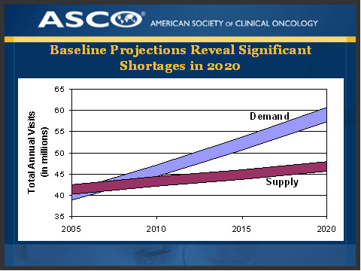
The Theory
Medical oncologists cannot follow survivors forever

Slide 18
The Theory
Medical oncologists cannot follow survivors forever
Survivors should be transitioned back to their PCP
The treatment summary/care plan can help facilitate that transition between medical oncologist and PCP
  Survivor empowered
  Critical information relayed to PCP (and other specialists)
  Aids communication between patient and providers
Survivors would no longer be “lost in transition”

Slide 19

The theory has some holes…

Slide 20
Feasibility issues aside…
With the document in hand, PCPs report they do not feel adequately trained to manage cancer survivors
  Not familiar with long-term side-effects and late-effects, unsure how to manage and differentiate from signs of recurrence
  Uncertain about ordering cancer screenings
Medical oncologists are reluctant to refer their patients back to PCPs for f/u care
Survivors report a strong preference to be followed by their oncologist
(e.g., Grunfield et al., 2011)

Slide 21
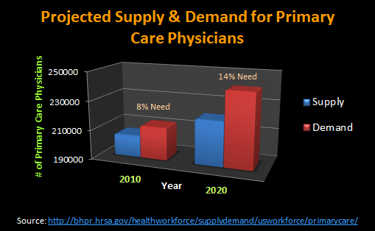
PCP shortage

Slide 22
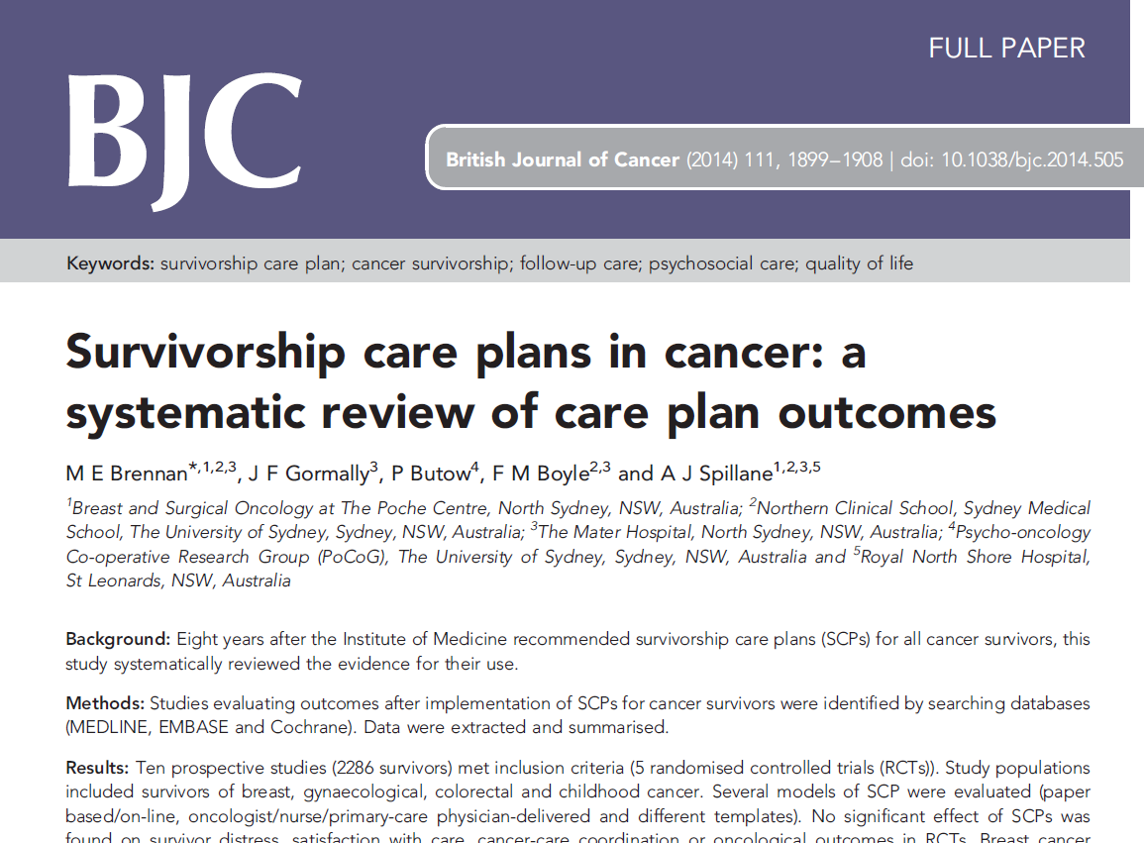

Slide 23
Brennan, Gormally, Butow, Boyle & Spillane (2014)
British Journal of Cancer
Systemic review of care plan outcomes
Ten prospective studies (n=2,286 survivors), five RCTs
Included survivors of breast, gyn, & colorectal cancers
No significant differences found on following outcomes:
  Survivor distress
  Satisfaction with care
  Cancer-care coordination
  Oncological outcomes
Investigators identified “feasibility” as a significant barrier
  1-4 hours to prepare

Slide 24
Summary: evidence
Treatment summaries & care plans do not improve care
PCPs report inadequate training
  Supply-demand problem of their own
Medical oncologists reluctant to refer
Survivors: strong preference to be followed by oncologist

Slide 25
What do survivors want?
Survivor-centered care

Slide 26
Diverging Agendas
National
Treatment summary
Treatment summary
Treatment summary
Surveillance
Primary care
Our Program
Fear of recurrence
Fatigue
Cognitive changes (“chemo brain”)
Pain/neuropathy
General anxiety & depression
Return to work

Slide 27
Our Survivors Don’t Want Treatment Summaries
70% of survivors chose not to participate in the treatment summary/care plan process – despite being free and arranged around their other appointments

Slide 28

Evidence of Survivors’ Preferences
50-80% of survivors endorse fear of recurrence; 25-40% report a moderate-high need for professional help
Plurality of counseling/therapy requests come post-treatment
Questions at educational events
Comments from family/friends
  “Why isn’t he accepting the good news?”

Slide 29
What is fear of recurrence?
Worry, anxiety, fear, rumination, etc. that…
  Cancer will return/relapse
  Cancer will spread
  A new cancer will develop
Not all fears are conscious!
  Symptom checking
  Irritability
  Hopelessness

Slide 30

The Course of Fear of Recurrence/Spread
Worse at some times than others
  Follow-up appointments
  Test results
  Hearing about cancer in the media
  Anniversaries
In the long-term, does not necessarily get better with time

Slide 31
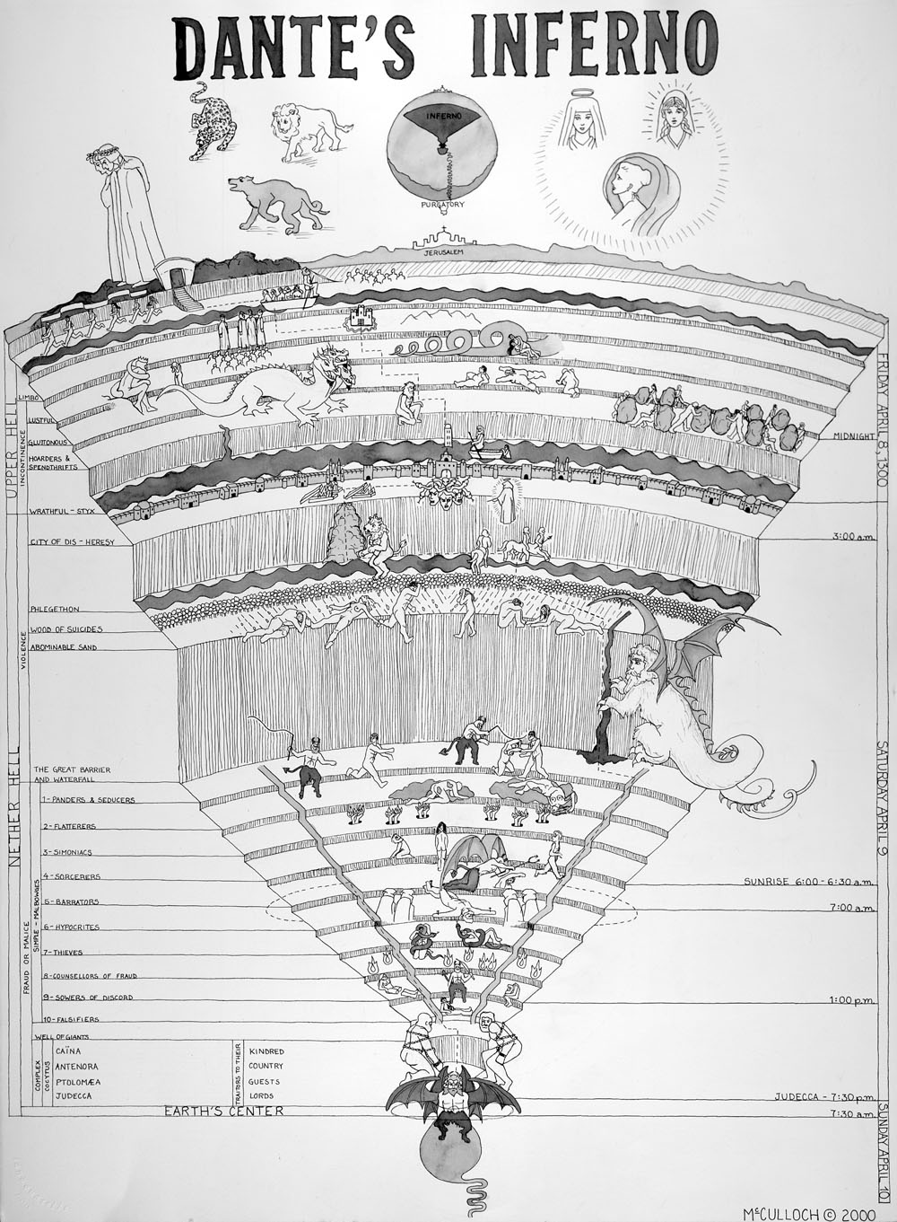
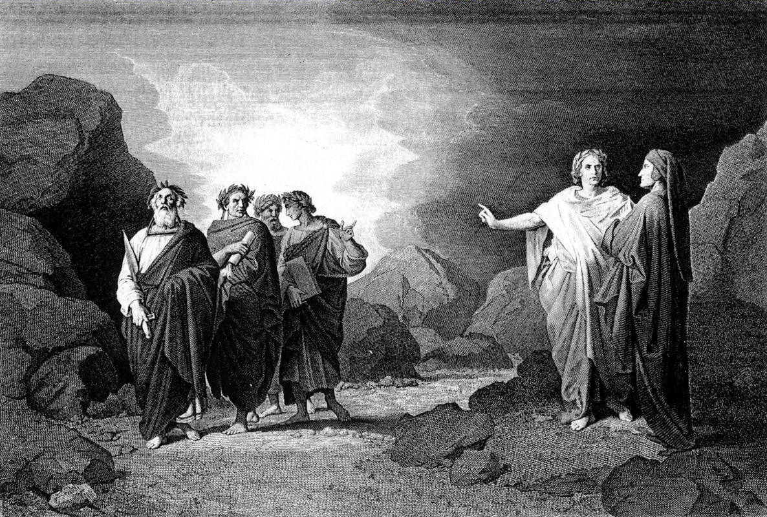
LIMBO

Slide 32

Sword of Damocles

Slide 33

Fear of Recurrence: Relevance for Medical Management of Cancer Survivors
Many survivors attempt to manage their anxiety through medical interventions:
  Additional office visits
  Push for more tests, scans, procedures
Notes:
So are there implications beyond the psychologist’s office? Does fear of recurrence have relevance for the medical management of cancer survivors?

Slide 34
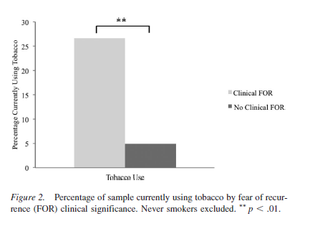
Fear of Recurrence: Relevance for Medical Management of Cancer Survivors
Many survivors attempt to manage their anxiety through medical interventions:
  Additional office visits
  Push for more tests, scans, procedures
Many survivors attempt to manage their anxiety with health behaviors that increase risk of recurrence
Smokers 2x risk of recurrence rate vs. those who stop smoking
(4x vs. nonsmokers)
Van Liew et al. (2014)
Notes:
So after looking into this fear of recurrence issue further, we began to see that it had clear implications for patient quality of life not to mention implications for the healthcare utilization and tertiary prevention. But the research to date on fear of recurrence is relatively limited; we set out to learn more without own independent research.

Slide 35
Summary: survivors’ priorities
Looking for help managing long-term and late effects of treatment, including psychosocial/behavioral challenges
  Fear of recurrence
  Fatigue
  Chemo brain
  Pain
  Anxiety/depression
  Return to work
Unmanaged fear of recurrence can directly impact medical care and outcomes

Slide 36
Toward a better model of Survivorship care
Innovation

Slide 37
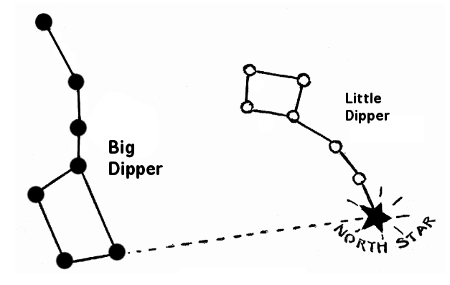
Finding the
True North Star
Priority #1:
  Identifying, managing and treating the long-term and late effects of cancer and its treatment, psychosocial/behavioral & physical

Slide 38
The IOM Report
BOX ES-1
Essential Components of Survivorship Care
Prevention of recurrent and new cancers, and of other late effects;
Surveillance for cancer spread, recurrence, or second cancers; assessment of medical and psychosocial late effects;
Intervention for consequences of cancer and its treatment, for example: medical problems such as lymphedema and sexual dysfunction; symptoms, including pain and fatigue; psychological distress experienced by cancer survivors and their caregivers; and concerns related to employment, insurance, and disability; and
Coordination between specialists and primary care providers to ensure that all of the survivor’s health needs are met.

Slide 39

A 2-year, $250,000 grant from the National Cancer Institute to study fear of recurrence
Chemotherapy-induced neuropathy

Slide 40
Finding the
True North Star
Priority #1 -- Intervention
  Identifying, managing and treating the long-term and late effects of cancer and its treatment, psychosocial/behavioral & physical
Priority #2-- Coordination
Developing, evaluating and disseminating new models of survivorship care

Slide 41
Developing New Models of Survivorship Care: Lessons Learned
Most survivors want their care in the cancer center
  Why not place an internist in the cancer center who specializes in cancer survivorship?
  Within the ACO model, PCPs could be assigned/offered based on medical history of patient (vs. geography)
Start early – survivorship care starts before treatment ends
  Survivorship nurse navigator embedded in treatment areas
  All members of the team can help prepare the survivor for the transition to life-after-treatment

Slide 42
Developing New Models of Survivorship Care: Lessons Learned (continued)
Survivors generally want individually-tailored care
  Resist the temptation to offer classes
  Caveat: Having classes to refer to (rehab, nutrition, etc.)
Standardize assessment – ask questions
  Survivors often have multiple post-treatment challenges but may not report unsolicited – they often have a sense something is wrong but cannot identify
  Specificity in assessment is important
    For example, fear of recurrence vs. anxiety
  Ask at multiple times
    Our Program: during treatment, near completion, post x2

Slide 43
Summary: New Models
Intervention and Coordination are key components of survivorship care
More research needed on treating long-term and late effects of treatment, including psychosocial challenges
New models of delivering survivorship care need to be developed and evaluated
Employ a survivor-centered approach

Slide 44
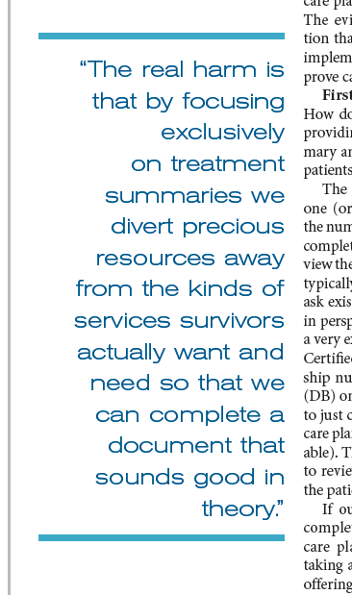
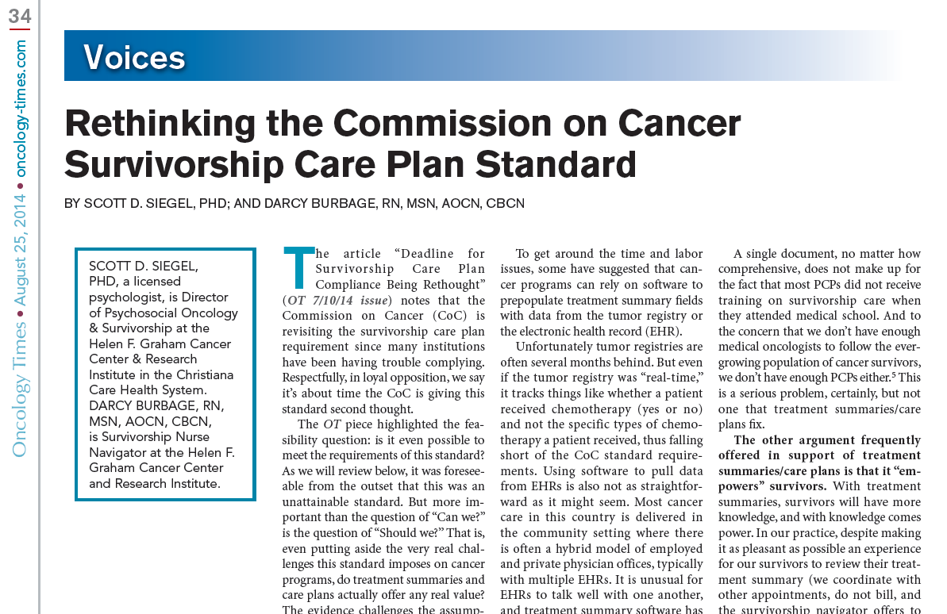
In Conclusion…

Slide 45


Slide 46
Thank you!

